Slide 1
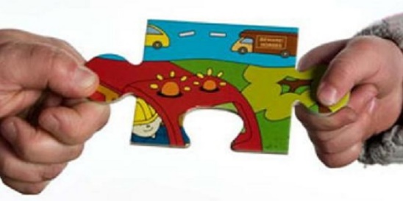
Part 12 Children and Young People (Scotland) Act 2014
Making it work for Parents with Learning Disabilities
Oonagh Brown
Policy and Implementation Officer (Parenting)
Oonagh.b@scld.co.uk
Andy Miller
Policy and Implementation Manager
Andy.M@scld.co.uk

Slide 2

Children and Young People (Scotland) Act 2014
Background to Part 12 of The Children and Young People Act
Overview of Part 12 of the Act
Discuss how Part 12 relates to Parents with Learning Disability
Explain Local Authorities responsibilities for carrying out the duties in Part 12 of the Act

Slide 3


Children and Young People (Scotland) Act 2014
The Children and Young People (Scotland) Act 2014 is underpinned by
The United Nations Convention on the Rights of the Child
Getting It Right For Every Child (GIRFEC)
The Act gives GIRFEC a legal footing

Slide 4
Part 12 Children and Young People (Scotland) Act 2014
“A local authority must make arrangements to secure that relevant services of such description as the Scottish Ministers may by order specify are made available for––
(a)each eligible child residing in its area,
(b)a qualifying person in relation to such a child,
(c)each eligible pregnant woman residing in its area,
(d)a qualifying person in relation to such a woman.”
Notes:
"Children And Young People (Scotland) Act 2014". Legislation.gov.uk. N.p., 2017. Web. 24 Jan. 2017.

Slide 5
Part 12 Children and Young People (Scotland) Act 2014
“An “eligible child” is a child who the authority considers—
(a) to be at risk of becoming looked after, or
(b) to fall within such other description as the Scottish Ministers may by order specify.”
Notes:
"Children And Young People (Scotland) Act 2014". Legislation.gov.uk. N.p., 2017. Web. 24 Jan. 2017.

Slide 6
What circumstances might make a child ‘eligible’?
“Disabled parents/ carers/ siblings may have additional support needs relating to physical or sensory impairments, mental illness, learning disabilities, serious or terminal illness or degenerative conditions. These may impact on the safety and wellbeing of their children, affecting their education, physical and emotional development.”
Notes:
"National Guidance For Child Protection In Scotland 2014". N.p., 2014. Web. 24 Jan. 2017 P. 119.

Slide 7
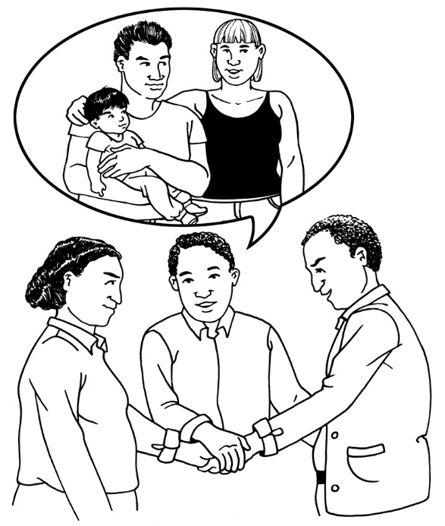
What circumstances might make a child ‘eligible’?
National Guidance states, “There should be specific consideration given to the support needs of parents with learning disabilities. International research has identified that children are more likely to be removed from with learning disabilities”
Notes:
.
CHILDREN AND YOUNG PEOPLE (SCOTLAND) ACT 2014: National Guidance On Part 12: Services In Relation To Children At Risk Of Becoming Looked After, Etc.. 1st ed. 2016. P.14.

Slide 8
Part 12 Children and Young People (Scotland) Act 2014
“A “relevant service” is a service comprising, or comprising of any combination of—
(a)providing information about a matter,
(b)advising or counselling about a matter,
(c)taking other action to facilitate the addressing of a matter by a person.”
Notes:
"Children And Young People (Scotland) Act 2014". Legislation.gov.uk. N.p., 2017. Web. 24 Jan. 2017.

Slide 9
What are Relevant Services?
“Under article 2 of the 2016 Order, relevant services for the purpose of section 68 (1) of the 2014 Act are specified as:
a)Family group decision- making services which means a service which is designed to facilitate decision- making by a child’s family in relation to the services and support required for the child; and
b)Support services in relation to parenting which means a service which is designed to increase parenting skills.”
Notes:
CHILDREN AND YOUNG PEOPLE (SCOTLAND) ACT 2014: National Guidance On Part 12: Services In Relation To Children At Risk Of Becoming Looked After, Etc.. 1st ed. 2016. P.8.

Slide 10
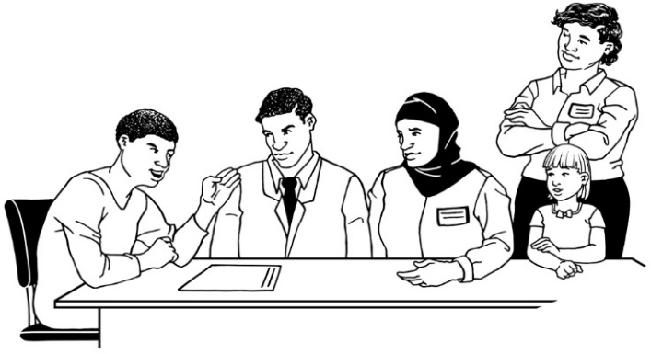
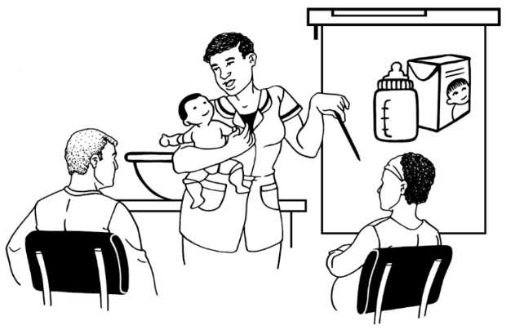
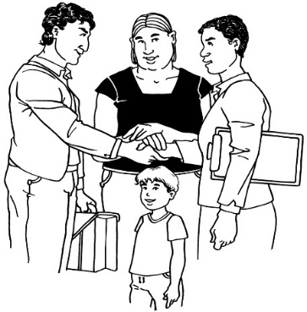
Family Group Decision Making Services and Parenting Support Services
Family Group Decision Making Services
Generally, this means providing a service involving the family in assessments and decisions which impact a child
Family Networks
Parenting Support Services
These can which can help to improve parenting skills and provide a range of support
Aberlour

Slide 11
Under Part 12 Local Authorities have the duty to:
Make relevant services available
To decide if a child is at risk of being looked after and if a person can be considered eligible

Slide 12

Implementation of Part 12 Children and Young People Act
Implementation of The Children and Young People (Scotland) Act 2014 began in August 2016
National Guidance for Part 12 published in December 2016

Slide 13
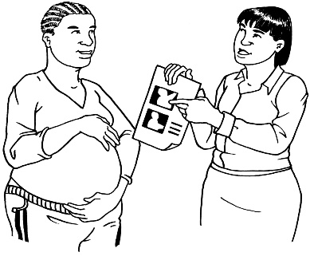
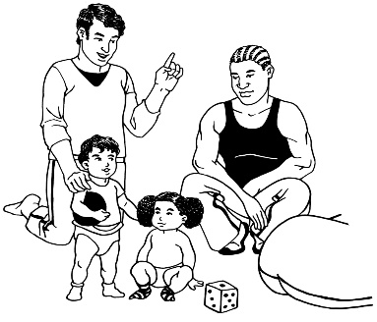
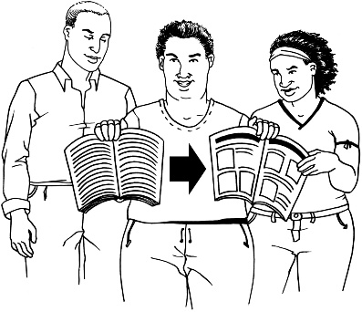
Ways for services to include the needs of parents with learning disabilities in Part 12 implementation
Clear communication and understanding
Use of role play
Step by step pictures showing how to undertake a task
Notes:
CHILDREN AND YOUNG PEOPLE (SCOTLAND) ACT 2014: National Guidance On Part 12: Services In Relation To Children At Risk Of Becoming Looked After, Etc.. 1st ed. 2016. P.22.

Slide 14
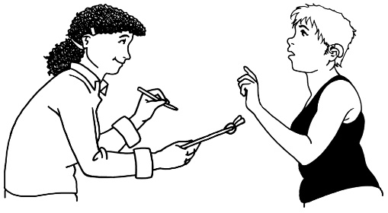
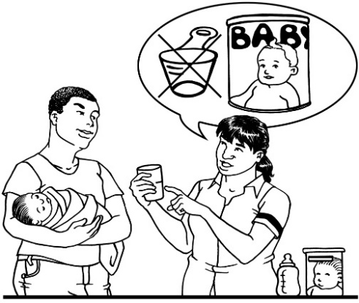
Ways for services to include the needs of parents with learning disabilities in Part 12 implementation
Repetition
Providing/ developing personalised ‘props’
Notes:
CHILDREN AND YOUNG PEOPLE (SCOTLAND) ACT 2014: National Guidance On Part 12: Services In Relation To Children At Risk Of Becoming Looked After, Etc.. 1st ed. 2016. P.22.

Slide 15

Accessible Information
“Local authorities must publish, in such a manner as it considers appropriate, information about the provision of relevant services; the ways in which a person can contact the local authority about the provision; and other matters the local authorities deem appropriate”
Notes:
CHILDREN AND YOUNG PEOPLE (SCOTLAND) ACT 2014: National Guidance On Part 12: Services In Relation To Children At Risk Of Becoming Looked After, Etc.. 1st ed. 2016. P.10.

Slide 16
What does Part 12 mean for Local Authorities/ Health and Social Care Partnerships?
Not a complete change of procedures and pathways relating to child wellbeing or child protection
Instead it involves additional consideration and developing on existing good practice
Examples of good practice in Dundee Multi agency Child Protection Procedures and Fife Multi Agency Child Wellbeing Pathway Guidance

Slide 17


What does Part 12 mean for The Third Sector?
Developing Supported Parenting Services
Providing Accessible information
Developing trusted links with statutory services

Slide 18





How can The Working Together with Parents Network support the implementation?
Supported Parenting Guideline Events
Through providing a hub for knowledge and information
By providing opportunities for network members to meet and share good practice

Slide 20

Discuss…
Thinking about the following,
Clear Communication
Use of role play
Step by step pictures showing how to undertake a task
Repetition
Providing/developing personalised props
What works well in your own practice?
What doesn’t work well in your own practice?
(10 Minutes)

Slide 21

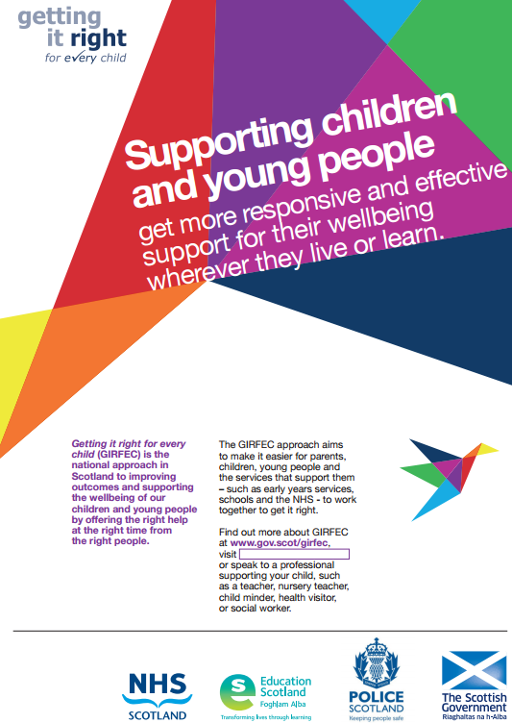
How do The Good Practice Guidelines Support Implementation of Part 12?
Supported Parenting: Background and Definition
Principles of supported parenting
Links between GIRFEC Principles and Supported Parenting Principles

Slide 22

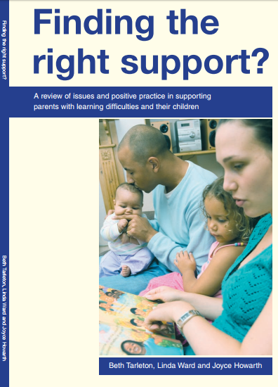
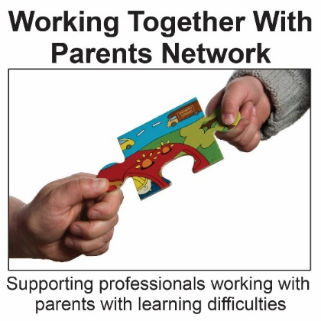
Background to Supported Parenting
Finding the right support? (2006)
Working Together with Parents Network (2006)
Guide to Supported Parenting (2015)
Refreshed Scottish Good Practice Guidance for Supporting Parents with Learning Disabilities (2015)
Notes:
Regan, Lorraine. "Finding The Right Support? A Review Of Issues And Positive Practice In Supporting Parents With Learning Disabilities And Their Children Beth Tarleton Finding The Right Support? A Review Of Issues And Positive Practice In Supporting Parents With Learning Disabilities And Their Children, Lindaward And Joycehaworth The Baring Foundation108 Free – Download Fromhttp://Www.Baringfoundation.Org.Uk/Findingrightsupport.Pdfhttp://Www.Baringfoundation.Org.Uk/Findingrightsupport.Pdf09538040620953804062". Learning Disability Practice 9.8 (2006): 27-27. Web.
"Guide To Supported Parenting". SCLD. N.p., 2015. Web. 24 Jan. 2017.
"Refreshed Scottish Good Practice Guidelines For Supporting Parents With A Learning Disability". SCLD. N.p., 2015. Web. 24 Jan. 2017.

Slide 23
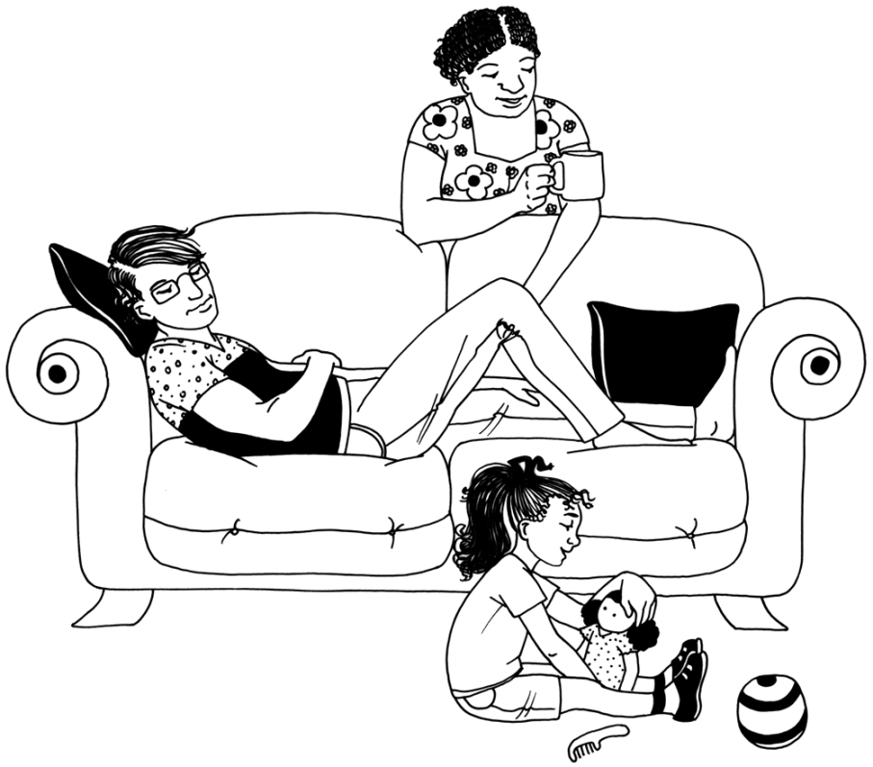
What is Supported Parenting?
Attitude not rules – it’s OK to parent ‘with support’
Holistic, flexible approach
Parents are a resource
Not a new approach
Notes:
Support based on an understanding and acceptance of the characteristics, life circumstances, needs, and desires of persons with learning difficulties

Slide 24
GIRFEC Principles
Supported Parenting Principles
Child-focused
GIRFEC ensures the child or young person – and their family – is at the centre of decision-making and the support available to them
Support based on respect for parents and emotional bond between parents and children
Support for whole family rather than individual
Support focused on building strengths
Understanding of the wellbeing of a child
GIRFEC looks at a child or young person’s overall wellbeing – how safe, healthy, achieving, nurtured, active, respected, responsible and included they are – so that the right support can be offered at the right time
Families are best supported in the context of their own extended families, neighborhoods, and communities
Notes:
"GIRFEC Principles". Gov.scot. N.p., 2017. Web. 24 Jan. 2017.

Slide 25
GIRFEC Principles
Supported Parenting Principles
Tackling needs early
GIRFEC aims to ensure needs are identified as early as possible to avoid bigger concerns or problems developing
Support from the start
Ongoing Support
Requires joined-up working
GIRFEC is about children, young people, parents, and the services they need working together in a coordinated way to meet their specific needs and improve their wellbeing
Parents seen as a resource not as a problem
Parents should be supported to feel in control and to experience being competent
Notes:
"GIRFEC Principles". Gov.scot. N.p., 2017. Web. 24 Jan. 2017.

Slide 26


Key features of good practice in working with parents with learning disabilities
1) Accessible information and communication

Slide 27
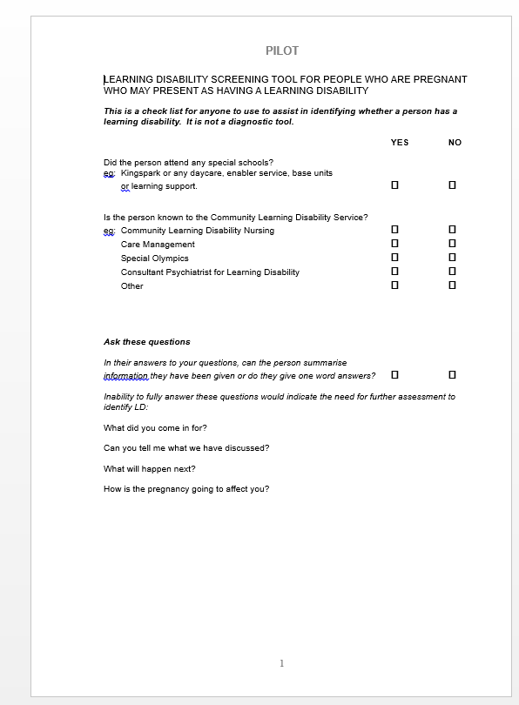
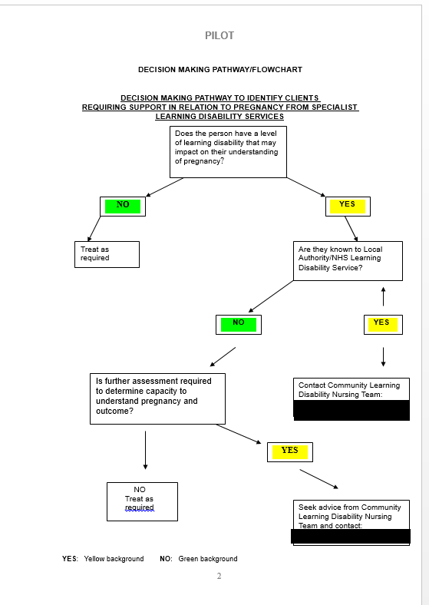
2) Clear and coordinated referral and assessment procedures and processes, eligibility criteria and care pathways

Slide 28

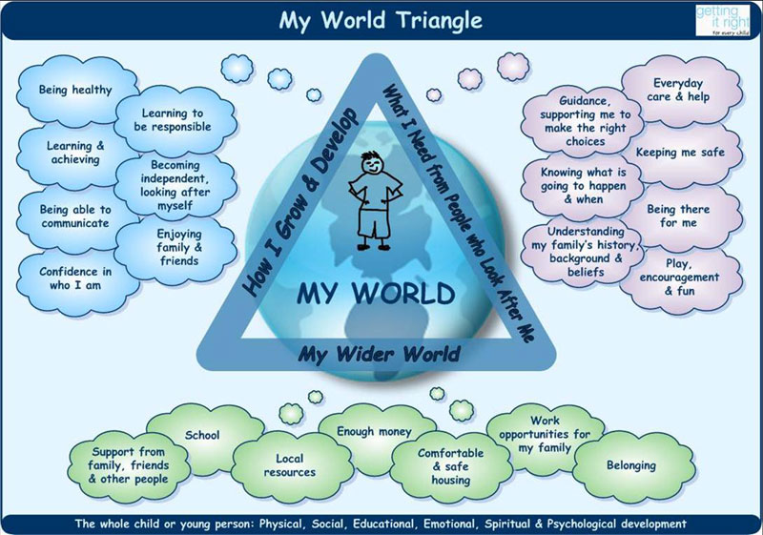
3) Support designed to meet the needs of parents and children based on assessments of their needs and strengths

Slide 29
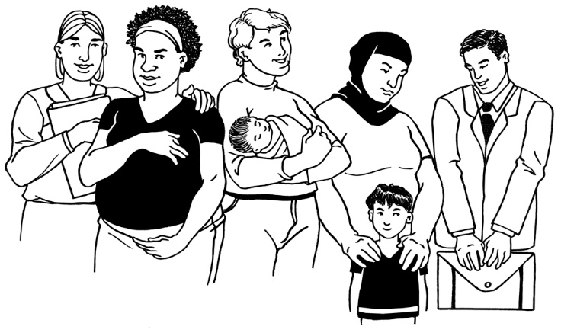
4) Long- term support where necessary

Slide 30
“Relationships matter in everyday social work practice. Many parents will not develop sufficient capability to meet their children’s needs without support”
Notes:
Ward, Harriet, Rebecca Brown, and Georgina Hyde-Dryden. "Assessing Parental Capacity To Change When Children Are On The Edge Of Care: An Overview Of Current Research Evidence". N.p., 2017. Web. 24 Jan. 2017. P. 20

Slide 31

5) Access to independent advocacy

Slide 32
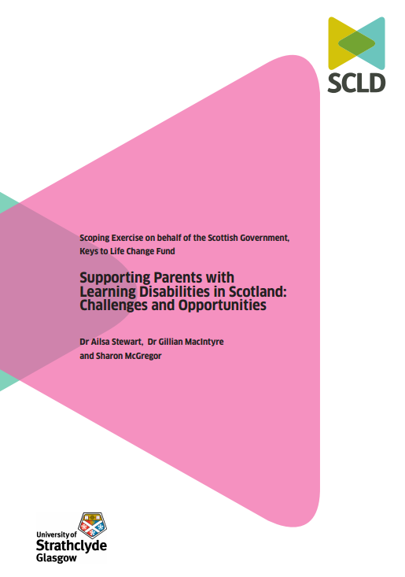
Supporting Parents with Learning Disabilities in Scotland: Challenges and Opportunities
Scoping Exercise on behalf of the Scottish Government, Keys to Life Change Fund
Dr Alisa Stewart, Dr Gillian Macintyre and Sharon McGregor

Slide 33
Overview
Published 17th of November 2016
Recommendation Areas
Local multi-disciplinary specialist teams should be developed
Develop and share local good practice
More consistent data collection
Social workers, midwives and health visitors should be better equipped to more confidently identify and work with parents with learning disabilities
Notes:
Local multi-disciplinary specialist teams should be developed to meet the support needs of parents with learning disabilities in line with the Scottish Good Practice Guidelines
Good practice already developed locally, for example in developing care pathways and accessible information strategies, should inform the development of good practice across the whole of Scotland
More consistent data collection should be developed to support better planning of services
Social workers, midwives and health visitors should be better equipped to more confidently identify and work with parents with learning disabilities

Slide 34
Implementation of the 12 Recommendations
Task Group has been formed following the recommendations and are drawing up an Implementation Plan based on the recommendations which they will oversee

