Slide 1
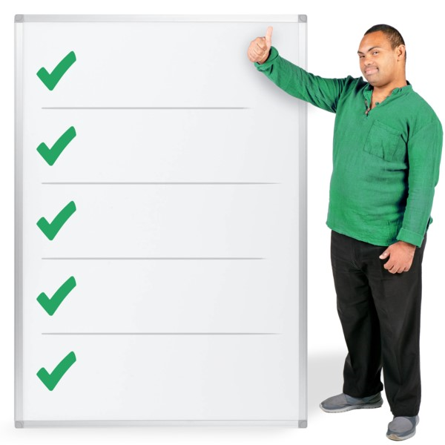
Top Tips
1. Make your response count

Slide 2
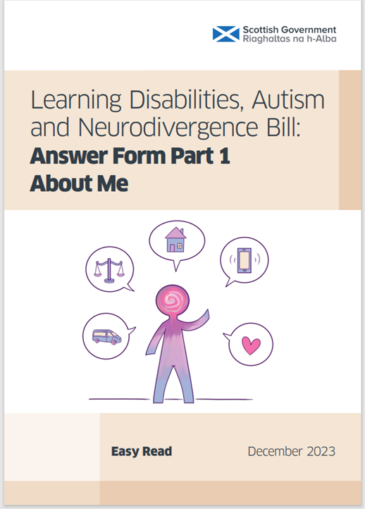

You must complete the About Me form for your response to count.

Slide 3
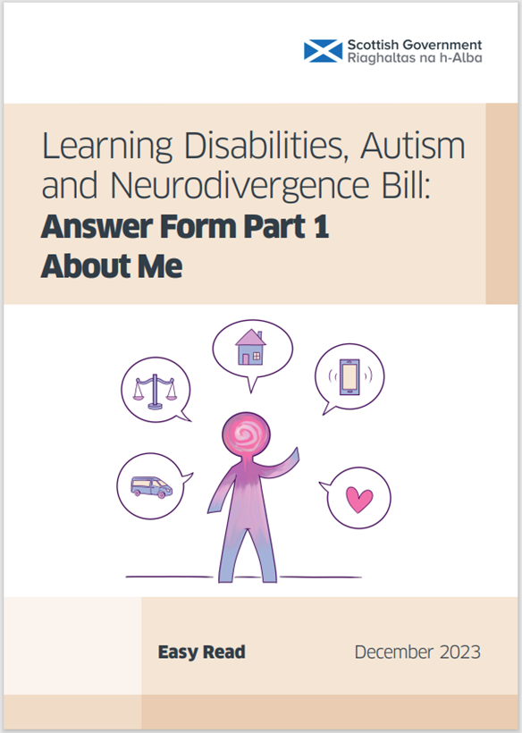





You must send both the About Me form and your response together.

Slide 4
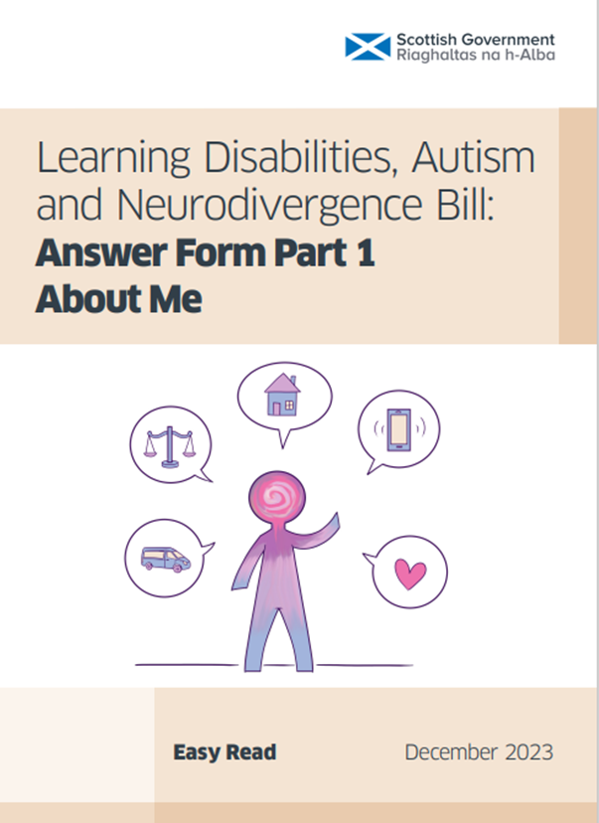
If you do not send your completed About Me form your response will not be looked at.

Slide 5

Why do I have to complete the About Me form?

Slide 6
The Scottish Government needs to make sure that it is a ‘human’ who is responding.
The questions on the About Me form helps them to check this.

Slide 7
The form asks questions about you and where you come from.
This will give the Scottish Government important information about who has responded.

Slide 8
Why is it so important?

Slide 9
If you do not send your completed About Me form your response will not be looked at.

Slide 10

A recent Scottish Government consultation had a good response.

Slide 11
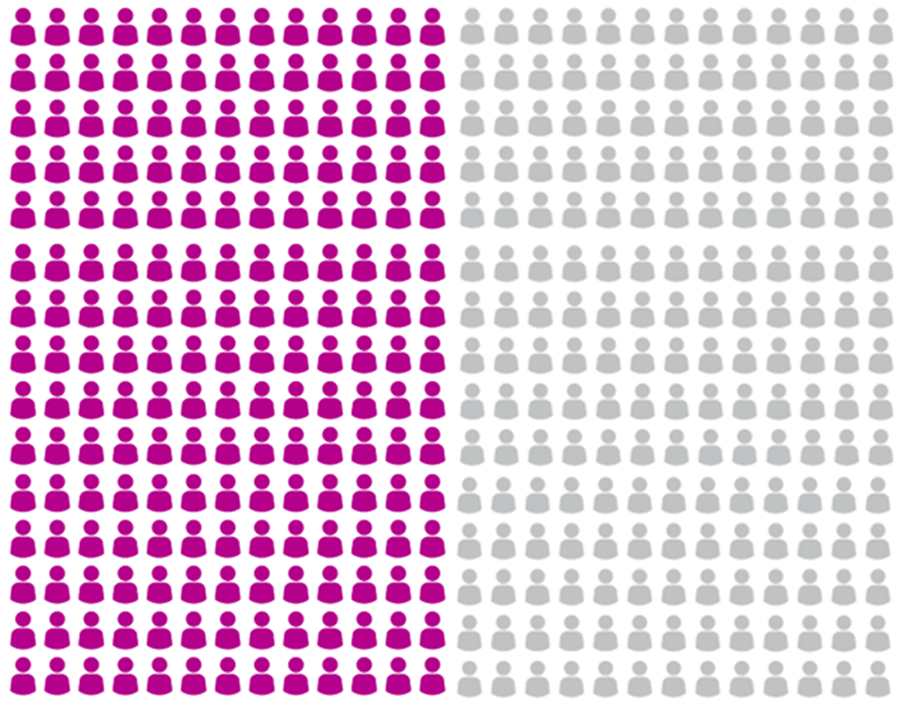
Almost half of the people did not return their About Me forms.

Slide 12

Their responses were not counted.
Their voices were not heard.

Slide 13
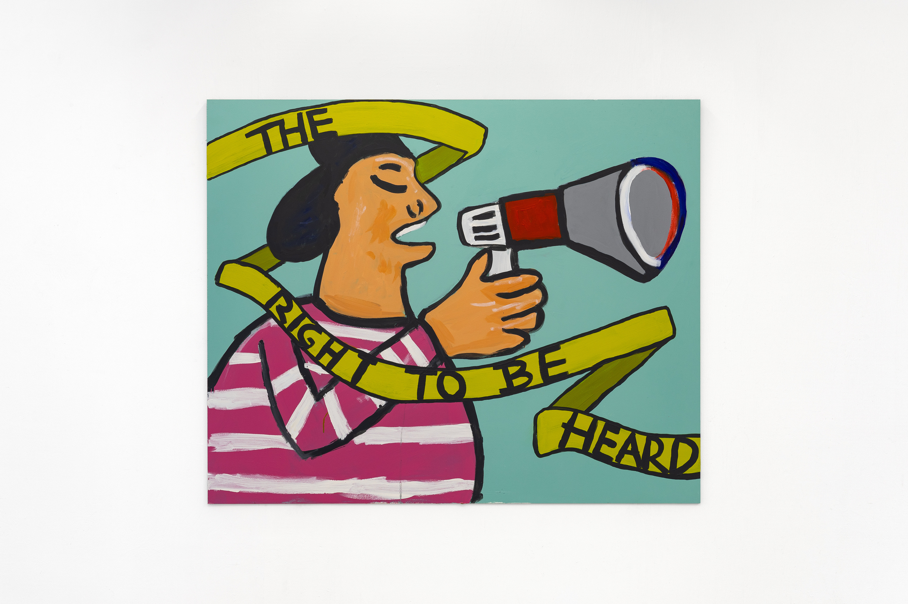
Make sure your voice is heard.

Slide 14
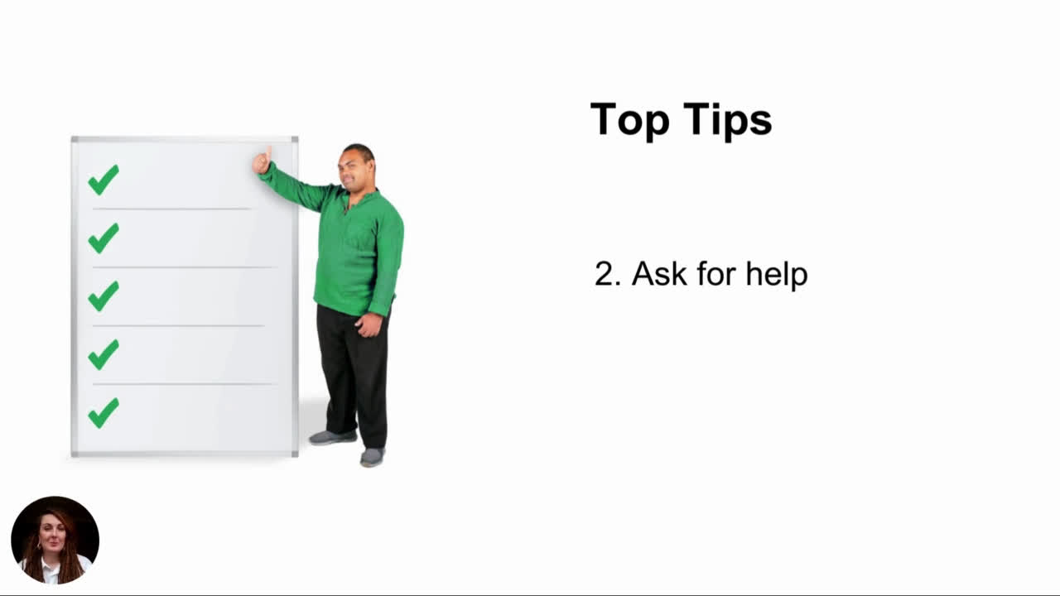

Slide 15
Top Tips
4. Ways you can respond

Slide 16

Each theme has an Easy Read.​
If you need hard copy Easy Read information, please email the Scottish Government.​
LDAN.Bill@gov.scot
Remember you also need the Easy Read About Me and Answers Forms

Slide 17
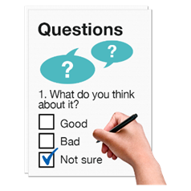
You have to answer the questions on the answer forms.
The same 3 questions are asked for most of the 22 themes.

Slide 18
These questions are
1. Which of these proposals do you agree with? Please tell us why?​
​2. Which of these proposals do you not agree with? Please tell us why?​
​3. Is there anything else that we should consider which is relevant to this topic?​

Slide 19
There are different ways that you can respond.
You choose the way that works best for you.

Slide 20

Audio recording

Slide 21

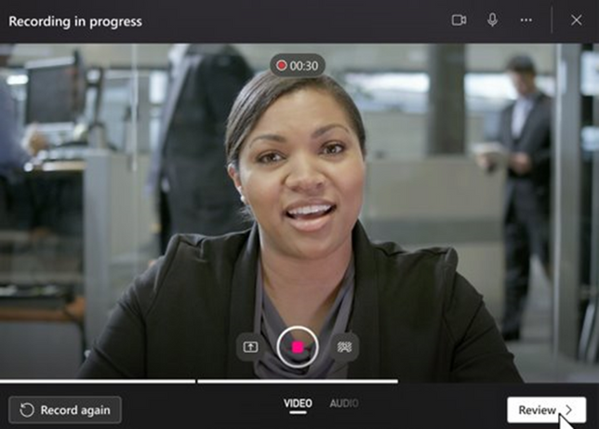
Video recording

Slide 22

Audio recordings and video recordings can be sent by email along with your About Me form to
LDAN.Bill@gov.scot

Slide 23
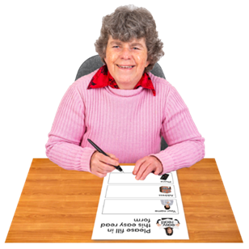
Paper copy
You can download the Answers Forms and About Me form from the Scottish Government website: consult.gov.scot
Or you can email LDAN.Bill@gov.scot to ask for the Answers Forms and the About Me form to be sent to you.

Slide 24

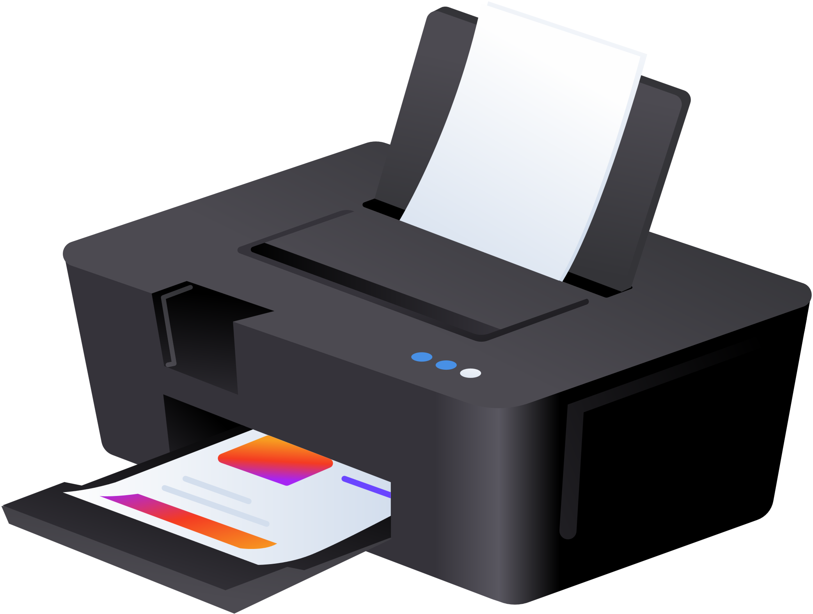
A fillable Easy Read version of the About Me form can be found on the SCLD website
scld.org.uk
You may find this easier to complete.

Slide 25
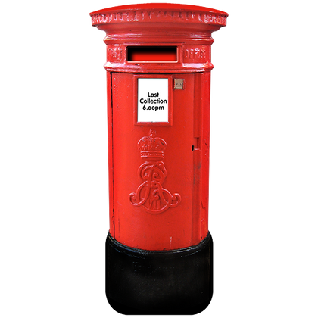
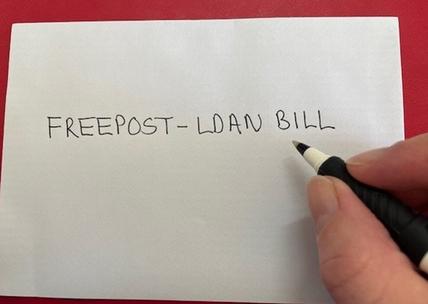


Paper copies of your Answer Forms and About Me form can be posted to
FREEPOST - LDAN BILL
Please make sure the words are all in CAPITAL letters.
You do not need a stamp.

Slide 26


Online
at Scottish Government consultations - Citizen Space
consult.gov.scot

Slide 27
Top Tips
5. How you can respond

Slide 28
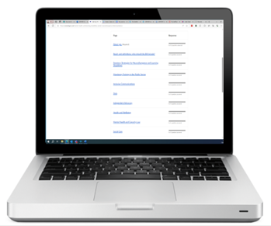

If you are completing your response online you need to complete the About you section at the top.
This is not in Easy Read.

Slide 29
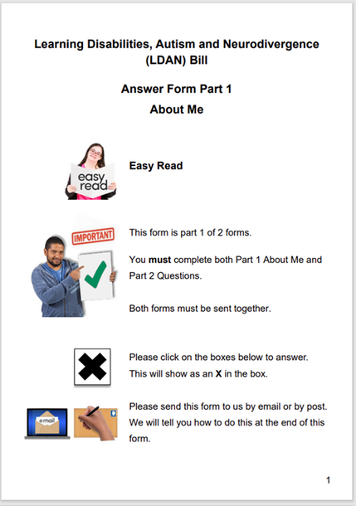


You can download an Easy Read About Me form from the SCLD website
scld.org.uk

Slide 30

This form can be printed and written on.
You can also save this form and fill it out on your computer.

Slide 31
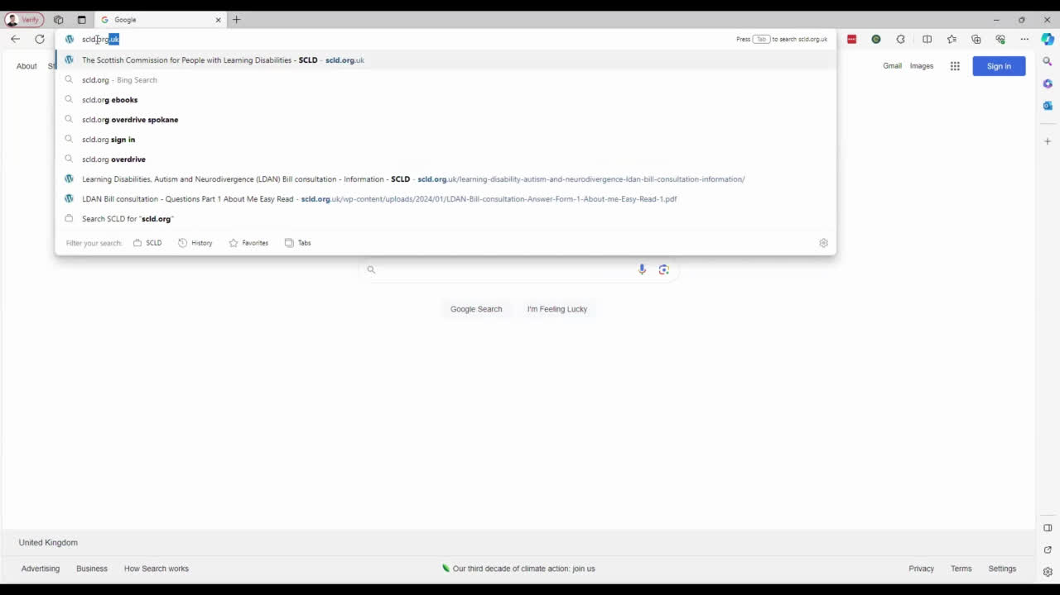

Slide 32
Top Tips
6. Make your response count

Slide 33
Remember to send both the About Me form and your response together.

Slide 34
If you do not send your completed About Me form your response will not be looked at.

Slide 35





Make sure you send your response to the Scottish Government before​
10pm
on Sunday 21st April 2024.​

Slide 36
Make your voice heard.

