Slide 1
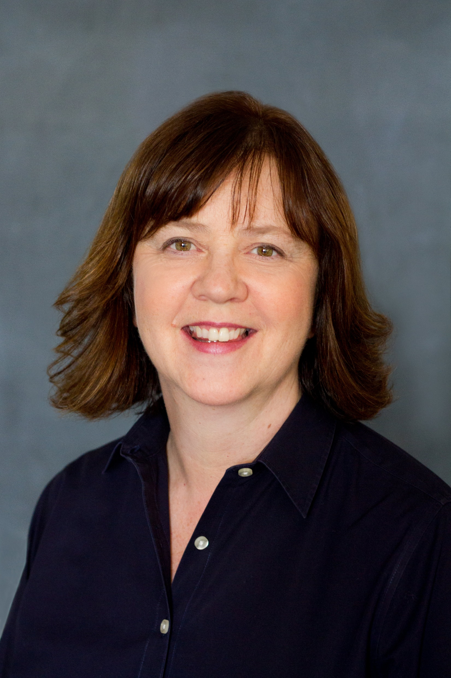
Introductions
Brian Collins
Senior Manager
Real Estate & Facilities
Microsoft Corporation
Gillian Maguire
Supported Employment Program Manager CBRE @ Microsoft
Zoe Porter
EMEA - HR Business Partner Sodexo @ Microsoft

Slide 2
Mission
Partner with vendors and local employment agencies to make a substantial difference in the lives of people with intellectual/developmental disabilities, who might otherwise be overlooked in the job market.
Notes:
GILLIAN
brief overview of the program for those maybe not familiar,
an overview of our currently placed positions
types of positions that we currently offer in this program.
Q&A

Slide 3
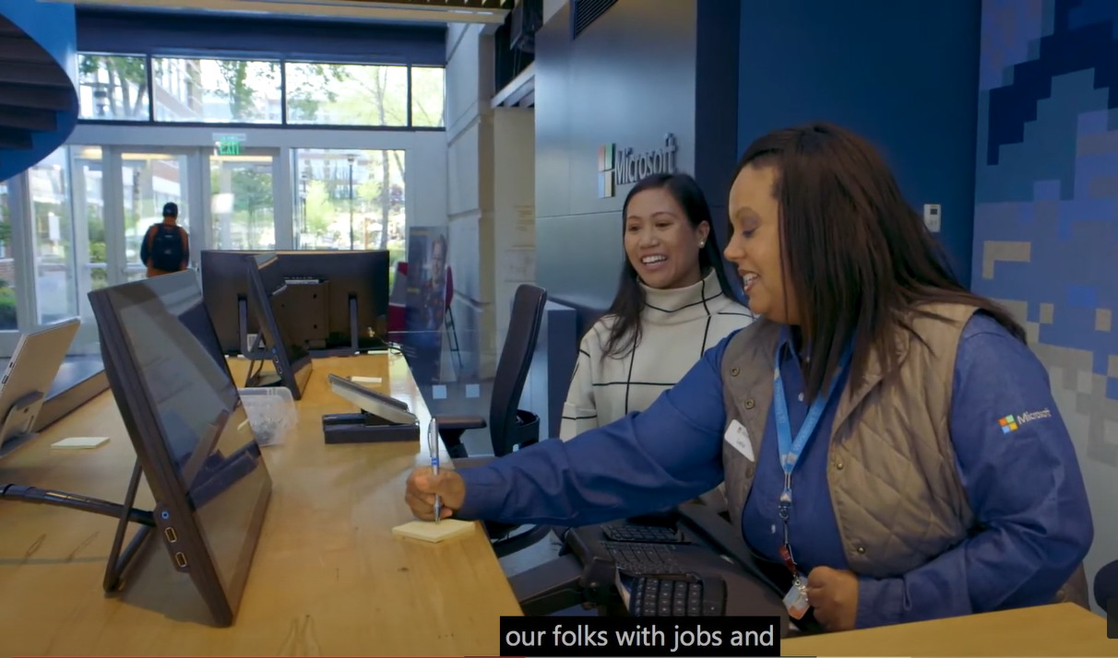
Program Overview Video
Notes:
Link to Program Overview video on @CREMicrosoft on YouTube: https://youtu.be/f-skHDKAwI8

Slide 4
Core Values of Supported Employment
Real jobs
Real wages
Working alongside non-disabled peers
Variety of roles
Full-and part-time
Notes:
Gillian
Core values of Supported Employment
Fahti Mohammed, MV Transportation, utility worker

Slide 5
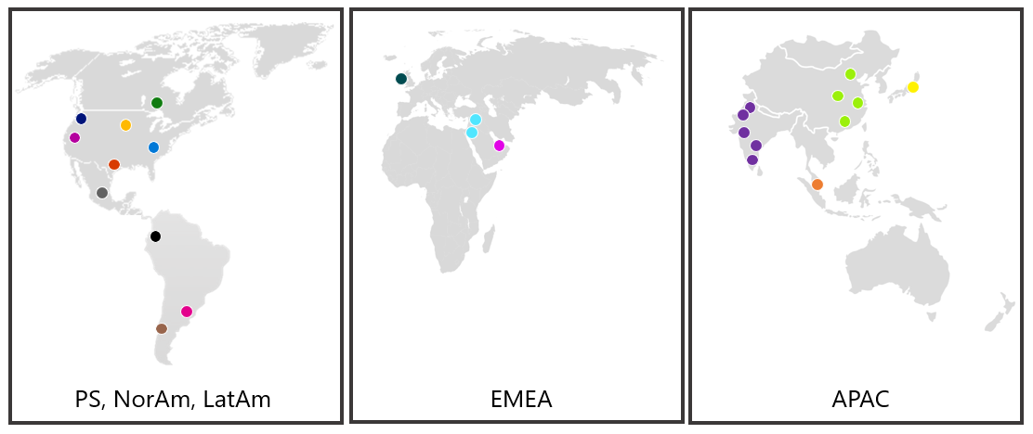
Program management by CBRE
Program Management – CBRE
Relationship Management
Best Practice Sharing
Toolkits and Trainings
Quality Processes
Job Coaching Partner Recruitment
Tier 2 Vendor Partner Recruitment
Job Development Consultation
Story Amplification & Celebrations
Global Expansion
Notes:
Gillian
Role of CBRE globally
Partnership with Sodexo in EMEA

Slide 6
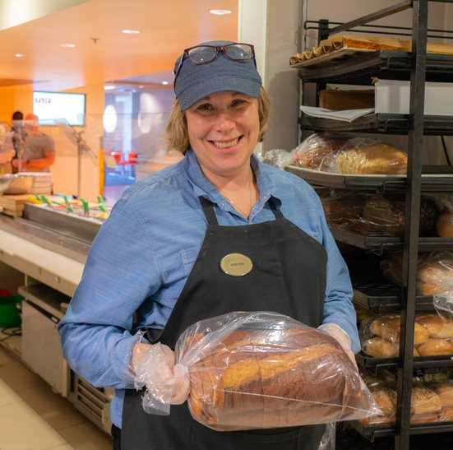
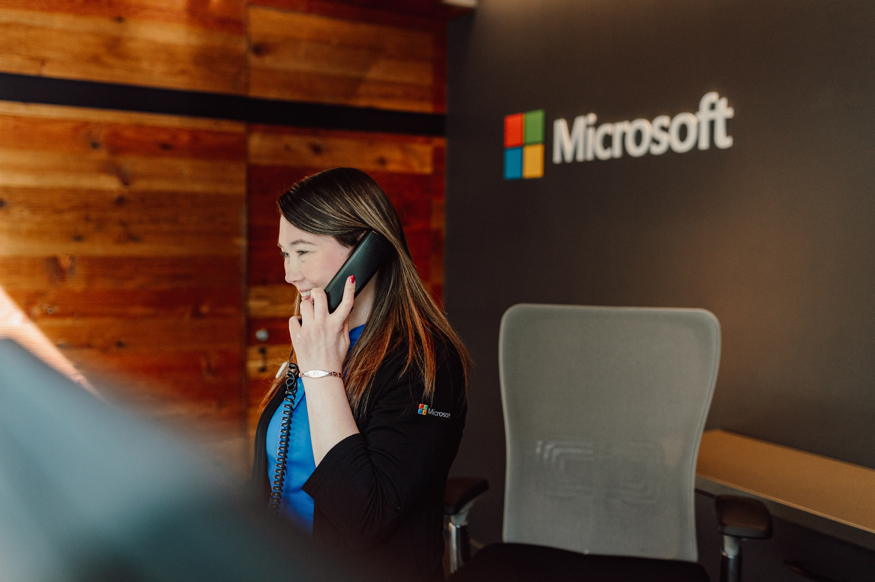
Supported Employment by the numbers
168
13
40
24
Employees in PS
Participating Countries
Coaching Partners
Vendor Partners
272
Supported Employees globally working today
362+
Supported Employees globally 2013-present
67
9
24
4
Employees in APAC
Employees in NorAm
Employees in EMEA
Employees in LatAm
30+
10%
Job Types
Attrition Rate
Notes:
Target was 200 hires
30+ job types
Very low attrition rate – people move on to new jobs, some move away, go to school

Slide 7
Vendors hiring Supported Employees
Food & Events Services
Lobby/Reception
First Aid Equipment
Audio Visual
Landscaping
Ideas?
Mail & Package Handling
Facilities Management
Janitorial
Notes:
Gillian
Microsoft if highly outsourced in Real Estate & Facilities
55,000 people work on the HQ campus in Redmond Washington
Many of those employees work for vendors to Microsoft in RE&F
HUGE OPPORTUNITY to increase job opportunities for ppl with disabilities

Slide 8
Over 30 Job Types in Microsoft RE&F Vendors
Administrative Assistant | Customer Service | Grounds Keeper Associate
Ambassador - Operations Center | Customer Service Freight Courier | Group Business Adminstrator
Audio Visual Assistant | Customer Service Mail Courier | Lab Technician
Bus Washer/Fueler | Customer Service Representative | Move Team Support Staff
Busser/Dining Room Attendant | Day Porter | Night Custodian
Café Ambassador | Dishwasher | Office Assistant
Carpet Technician | Event Services Technician | Project Coordinator
Catering Administrative Assistant | Facility Inspector | Reception/Host/Concierge
Catering and Café Assistant | Food Service Worker | Recycle Technician
Common Area Reset Technician | Food Transporter | Warehouse Supplies Controller
Copier Room Assistant | Furniture Maintenance Technician | Warehouse Technician
Notes:
Part time
full time
going rate – at least minimum wage

Slide 9
Obstacles/Challenges
Inclusive recruitment lessons learned.
Focus on the role, skills
Unconscious bias
Welcoming workplace
Career opportunity
Job descriptions – can you shape tasks for the individual?
Utilizing job coaching agencies to assist in the job description shaping process.
Sodexo Toolkit – central repository/bank of information/tools/job descriptions.
How to organize a program to maximize effectiveness.

Slide 10
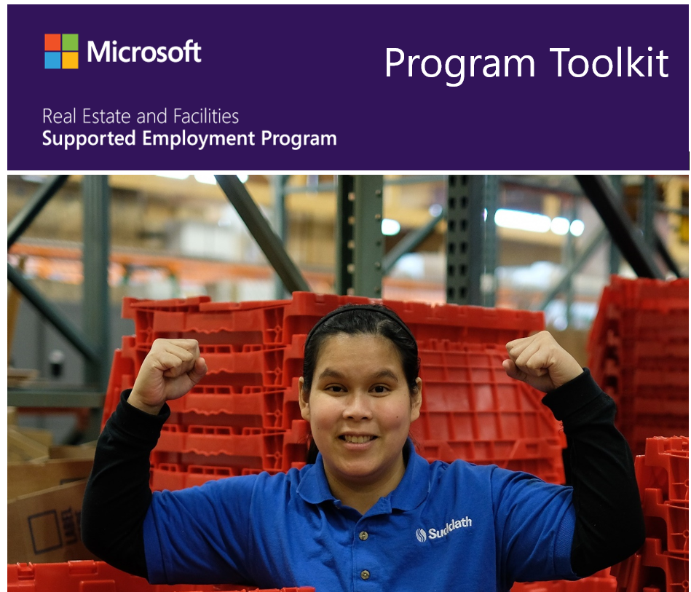
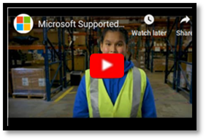
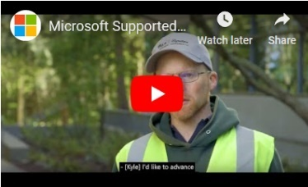
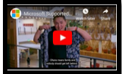
Learn more and Q&A
aka.ms/supportedemployment
Gillian Maguire: v-gimagu@microsoft.com
Zoe Porter: v-zoport@microsoft.com
Notes:
All information on website is open source and free to the public
Feel free to contact me/Brian if you’d like us to talk about the program to businesses you are working with.

