Slide 1
Attachment, Complex Trauma and Behaviours that Challenge.
Dr Cathy Harding
Consultant Clinical Psychologist, Liberty Care , South Wales Cathy.harding@libertycareltd.com
SCLD August 2020

Slide 2
What do we mean by Attachment
An intimate relationship with a primary caregiver
It is as important as food, shelter as provides us with protection, comfort and support
Continues throughout lifespan.
We need our attachment system more when we are frightened.
As young children people work out how to make sense of behaviour and feelings dependent upon their care-givers
Allows you to form blueprints about how to see your self and others (internal working models).

Slide 3
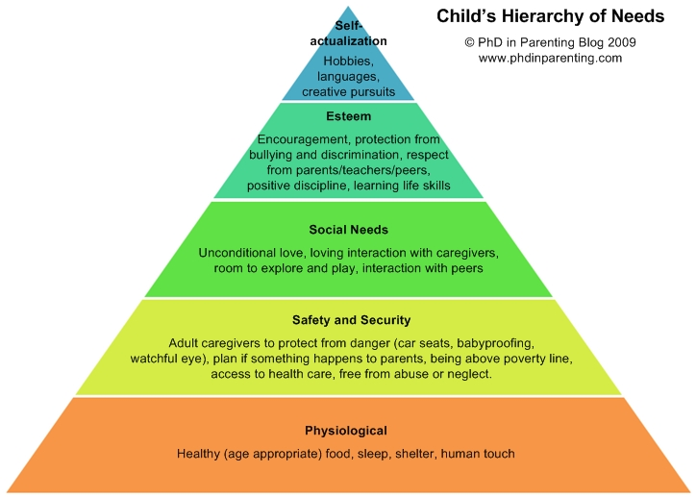

Slide 4
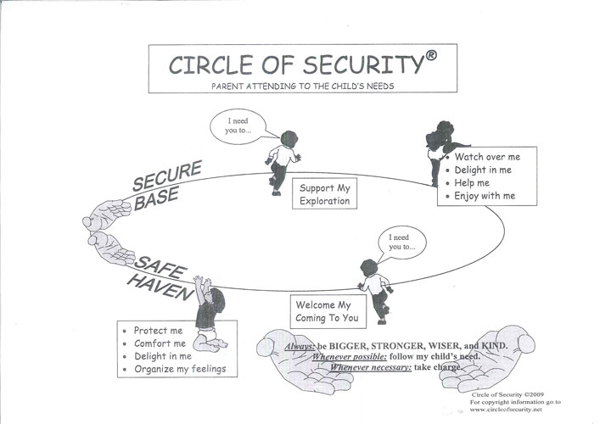

Slide 5
Children who are securely attached can rely on their caregiver to keep them safe and help them grow/develop. The learn their needs are important and others can help them.
Children who do not develop secure attachments are more likely to adapt their attachment behaviours to develop strategies to help them stay close to their parent without risking further distress or rejection.
They might be very suspicious or scared yet not use caregiver to seek support
Can lead to miscuing.
Children who receive frightening care will experience ‘disorganisation of attachment responses where they seem unclear how to interact- parents are both reassuring and frightening.

Slide 6
The impact of attachment disruption across the life span.
Attachment
Consistent, sensitive approach
Emotional regulation
Ability to monitor and adjust the duration and intensity of emotional reaction.
Over arousal and overwhelming and so the focus is on reducing on distress
Empathy
To think of the needs of others
Dismissive, inconsistent responses
Pro- social behaviours
OR
Theory of mind
To cope with stress
To use others for support.

Slide 7
Secure attachment might be harder in Learning disability .
Evidence that the diagnosis of learning disability in itself changes the parental relationship – and alters the interaction of attachment.
High prevalence of Adverse Childhood Experiences
Risks of miscuing
Importance of secondary handicap (Sinasson, 1992)
“when our existence is reflected back to us tinged with contempt, disappointment, distance or not at all it has a profound effect on identity” Greenhill, 2011

Slide 8
Risks to attachment when you need life long support
Frequent changes in staff personal
High workload of staff
Discontinuity of staff presence
Limited opportunities for individual support
Organisational cultures which value independence from staff rather than mutual interdependence
Lack of support for paid carers in negotiating relationship boundaries.

Slide 9
Complex Trauma
Complex trauma usually over several occasions. Inds who should be trustworthy cause harm/abuse, neglect, interrupt emotional development through trauma (overwhelming the persons ability to cope).
People with learning disabilities are at a higher risk of early abusive life events and may have repeated experiences of abuse
People with learning disabilities are more often exposed to potentially traumatic events than people without learning disabilities, including:
sexual and physical abuse
bereavement
life-threatening illness or injury
Placements away from home/family/restraint

Slide 10
Coping with trauma
Not wanting to take a parental or disempowering stance or risk suggesting that people will a learning disability cannot be resilient (Wigham and Emerson, 2015)
Children with learning disabilities may have less coping strategies to help them deal with and make sense of the trauma:
difficulties with problem-solving skills
difficulties with verbal skills
less sexual knowledge (financial knowledge)
less understanding of what is appropriate or not appropriate behaviour of others
less developmental clues to trauma
less access to support, including on-line

Slide 11
Attachment, Trauma and Neurobiology

Slide 12
Understanding the Biology
Neocortex
Limbic system
Diencephalon
Brain stem
Neocortex – thinking brain
Limbic system – emotional development
Diencephalon –
understanding of our
bodies, movement,
eating control etc.
Brain stem - basic fight and flight/freeze

Slide 13
Attachment, Trauma and Challenging behaviours

Slide 14
What might trauma present as?
Aggressive or violent behaviours
Self harm
Refusal to cooperate or disobeying commands
Withdrawal and sleeping at inappropriate times
Hypersensitivity
Sensation seeking
Task avoidance
Relationship avoidance
Extreme attention seeking
Poor social skills
Big reactions to small events.
Practice guidelines for trauma informed care and service delivery , Kezeler & Stravropoulos, 2012

Slide 15
What else you might notice
Poor turn taking
Talking too much
Not understanding some words or dissociation
Misreading facile cues
Difficulties with proximity/touch
Preferring younger games
Chaos within life, not learning from mistakes
Hard to get to know/feel close to
Odd reactions and behaviours.
Lying - weird explanations
Blaming others
“Playing” people against each other
Focus on immediate and not anting to talk about past
Unable to reflect on incidents
Compartmentalised memories
Disproportionate behaviour.

Slide 16
So, what do we know about attachment and behaviours that challenge.
What we know is that;
Attachment insecurity/disorganisation as a risk factor for family/placement breakdown and so consideration of this is needed in our formulations.
Case series show that attachment based behaviour modification has superior outcomes to standard ABA
Considered the evidence from Schuengel et al 2011

Slide 17
Adults who have had attachment difficulties tend to:
Invalidate their own emotional experience
Be unable to consistently problem solve
Be unable to reward and nurture self
Have self hatred following failure to achieve goals
Experience shame for emotional vulnerability
Also specific coping strategies such as dissociation, self harm, shielding from shame and re-enactment which can occur.

Slide 18
What Dan Hughes says
“..develop a rigid sense of self reliance which becomes a compulsive need to control all aspects of their environment….caregivers much be controlled if the (person) is to keep themselves safe” (Hughes, 2004).
Conference Jan 2016 in Edinburgh on YouTube

Slide 19
Blocking trust
Young children block the pain of rejection by blocking the capacity for delight –as their experience is that the world does not give delight/comfort/joy
Intimidated by big feelings
Hypervigilance to emotionally arousing situations
Give up on learning new things
Have negative bias
Don’t know safety ques
Focus on objects/processions rather than relationships
Block off their inner life (so can seem very distant)

Slide 20
Blocked care
To protect against the rejection we block off the care
Defensive and not open
Focus on behaviours and not meaning
Reactive and not proactive
Repeat doing what is not working
Look to correct not connect.

Slide 21
Assessment – integrating attachment & PBS
Alan Skelly suggests:
Functional assessment of behaviour
Presence of insecure behaviour (MAST)
Account of the emotional responses to behaviour (ambivalence, hostility, loving contact?)
Assessing the conditions for security
“what’s the last thing you did together/jointly
“When was the last time you had a really good laugh together?”

Slide 22
Relational Risk Questions
Does the behaviour threaten to break, damage or stress-load our working relationship?
Do I feel hostile or ambivalent to the person I am working with?
Is an earlier pattern of rejection and relationship breakdown happening again?
Does the person seem fearful, unsure how to react to me, or show strange behaviours?
Do I feel emotionally unavailable to or cut off from the person?

Slide 23
Functions of behaviour
Short term
Longer term
Escape/avoidance
Attention
Tangible
Sensory
Automatic
Loneliness
Control
Power
Self Esteem
Patterson, 2016

Slide 24
Relationships are important
Promotion of positive, significant, enduring bonds with carers and others being a central goal of any intervention because without it there’s risk factor for placement breakdown
Body of research that shows that regardless of the model the relationship is at the heart of successful changes.
In non-learning disability literature increasing attention is being paid to the importance of trauma and early attachments in understanding adult distress.

Slide 25
Relationships are Important – and go both ways.
Challenging behaviour generate powerful feelings: engaging in a relationship with people regardless of this is important
These feelings exist in the here and now and over time
They can become barriers to empathetic relationships: if unshared they can ; lead to toxic cultures developing and make it hard to provide good enough care.

Slide 26
Attachment and PBS plans
There are many ways to assess attachment and attachment behaviours, what matters most is that we consider it.
Formulating in a way that helps to make sense of how the persons early experiences have lead to psychological vulnerabilities – relationships difficulties and ‘behaviours’ as a way of coping with these….to help make relationships more predictable.
Each component of a PBS plan could include a statement about how this is helping the individual to form positive relationships and remove potential barriers to this (Skelly 2017).
Attachment can be thought about within the PBS framework and how our primary, secondary and reactive strategies can help build attachments, mitigate against damaged attachments and repair when this occurs.

Slide 27
Risks of not considering attachment
Manage behaviour in short term but don’t think about emotional skill development
People increase the riskiness of behaviours and change the type of behaviour as the underlying need is not being met.
That staff are burnt out and so do not remain in post for long therefore further damaging attachment relationships.
Repeated breakdown of placement which again perpetuates the lack of attachments
Attachments can be used as an outcome measures to measure the success of PBS plans.

Slide 28
People need to be provided with good enough care which is reliable, containing, empathetic and attuned.
(Hughes)
Notes:
S

Slide 29
Key resources
Attachment and intellectual and Developmental Disability, Eds H.K. Fletcher, A Flood & DJ Hare
In cooperating Attachment Theory Into Practice: Clinical Practice Guideline for Clinical Psychologist working with People who have intellectual Disabilities.
The last frontier: Practice guidelines for treatment of Complex trauma and Trauma informed care and service delivery.
Taking time Framework: A trauma informed framework for supporting people with intellectual disability (NSW)
BILD Webinar re attachment and trauma and people with LD; https://www.bild.org.uk/attachment-difficulties-complex-trauma/
A useful video re neurobiology -
https://www.youtube.com/watch?v=4-tcKYx24aA&feature=youtu.be

