Slide 1
A young persons with story of trauma and how PBS is helping her and us heal.
Mandy Mitchelmore
Parent/ Carer

Slide 2
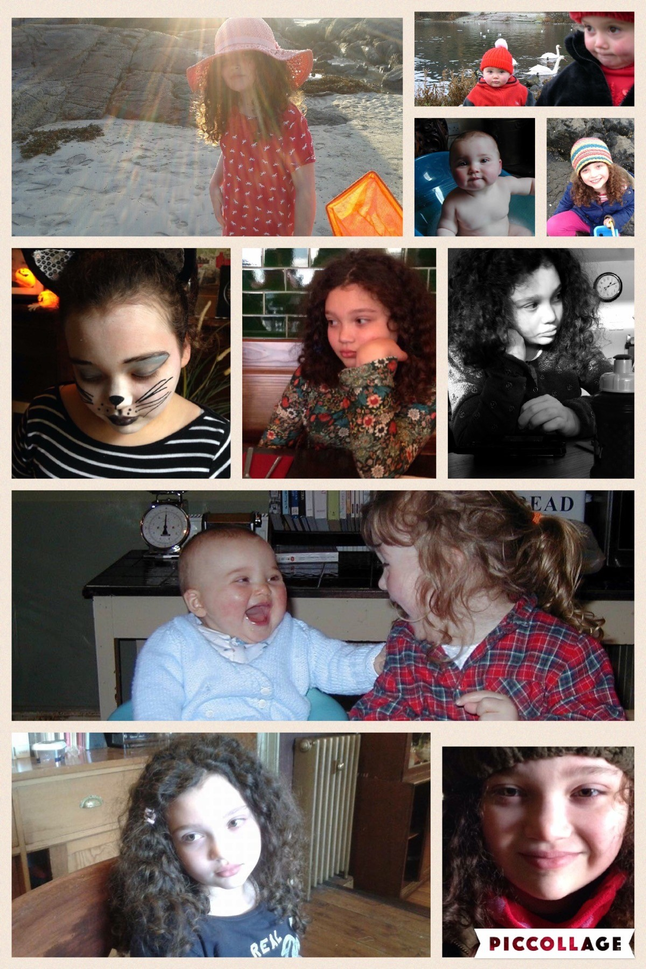
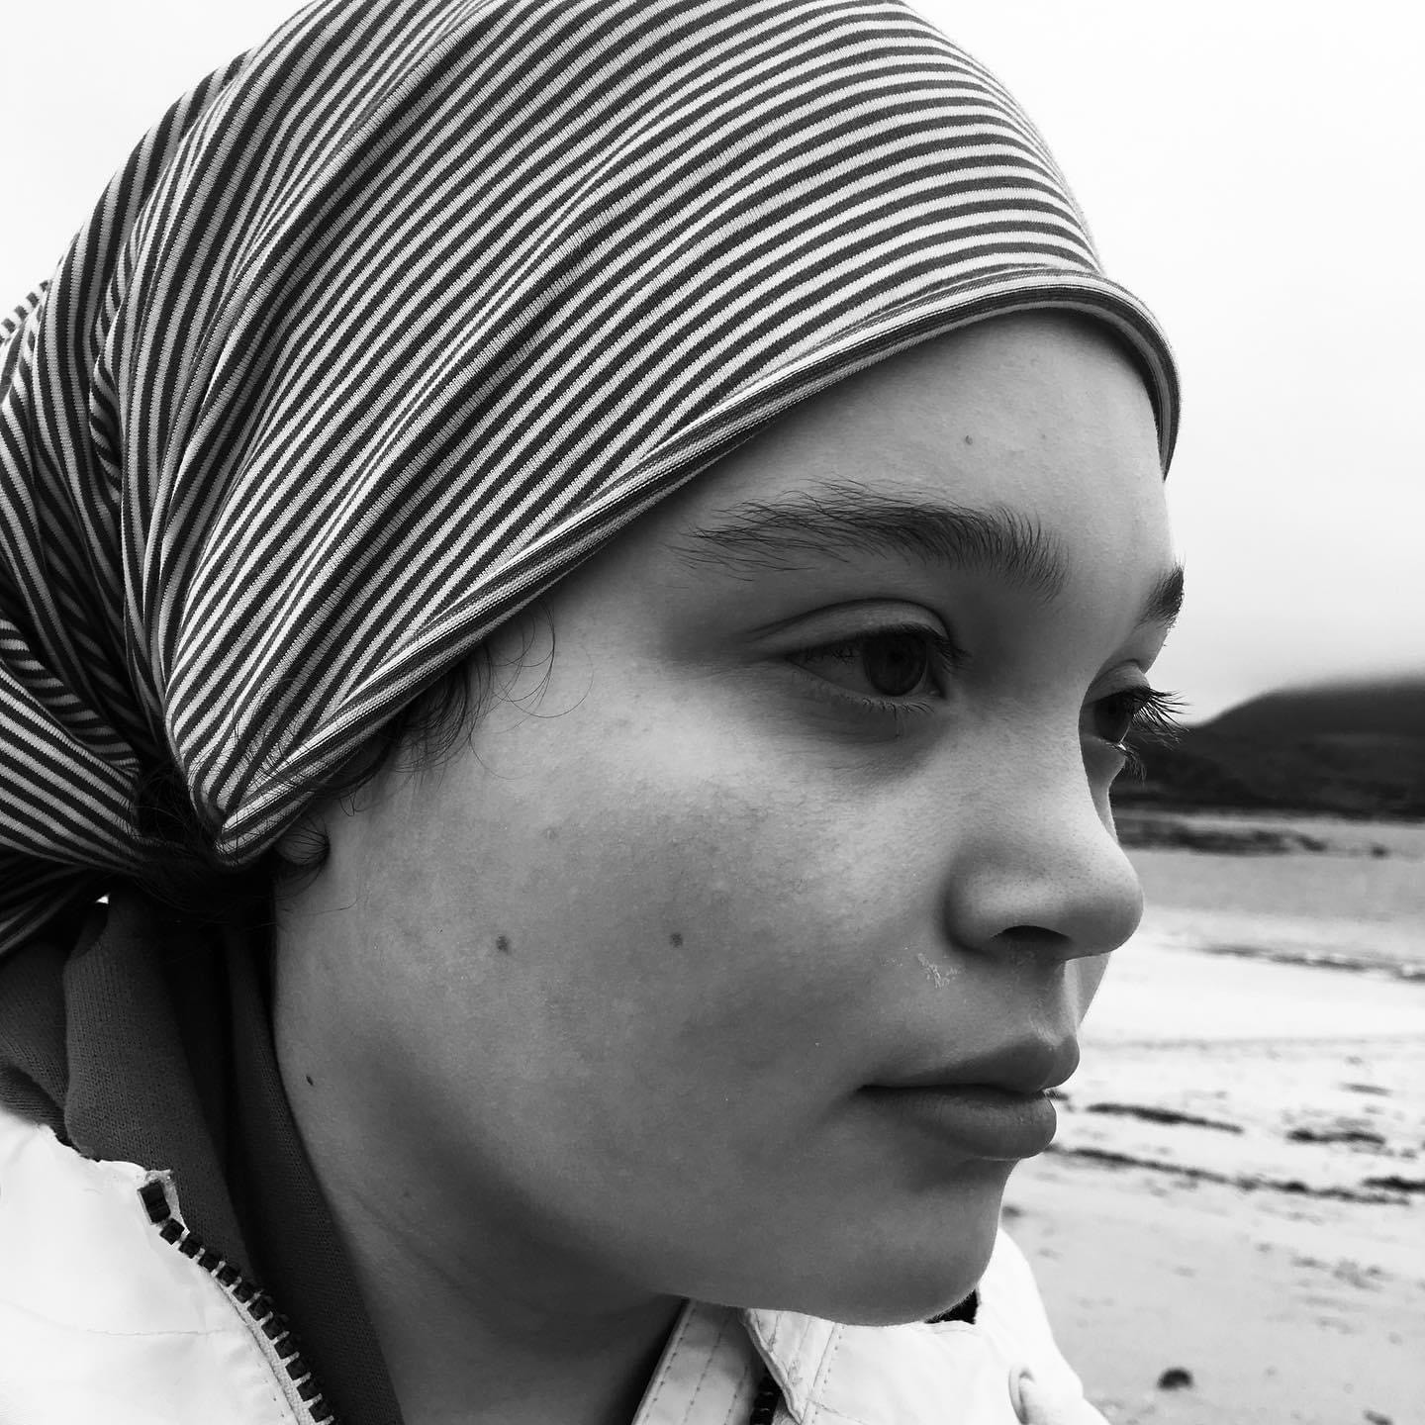

Slide 3
Medical Picture
Delayed Social, emotional and communication due to
Left Hand Side Porencephalic Cyst
Mild RHS hemiplegia
Symptomatic focal epilepsy
Electrical Status Epilepsy in Slow Wave Sleep
Sensory Processing Disorder
Significant learning disability
ASD Diagnosis aged 16.
She experienced trauma in the womb- a perinatal stroke at 24 weeks, developed seizures age 3- 200-300 a month for nearly two years followed by a rare type of epilepsy ESES that can create cognitive decline, short term memory loss and significant communication disorders in terms of processing and understanding of language.
She went through 3 drug trials that saw her become anorexic, depressed ( she stopped signing !) , exhausted, confused and upset, and finally a trial of steroids that affected her health – but nothing stopped the ESES.
Neuropsychological assessment also showed significant EEG discharges without visible seizures…
During this turbulent time she began to exhibit "behaviours that challenge” and was first placed in seclusion outside a classroom aged 5 in primary 1.

Slide 4
Introduction
PBS approaches have kept us together and enabled her to start to heal. To be herself and be understood. She has brought people together, taught us about ourselves and the importance of positive relationships, compassion and integrity.
Sadly she is just one story in amongst another 720 vulnerable young people with LD, ASD and complex needs who can suffer layers of emotional, physical and sometimes degrading practices.
The responses we make towards organic behaviours that challenge can feed that trauma, approaches based on power struggles, control and an assumption of deviance led in my daughters case to physical restraint, seclusion and emotional trauma.

Slide 5
Extracts- Perceptions and Language- Layering ….
First BSP- refusal to participate, independence issues, hitting out and spitting at adults- age 6 1/2
Removed from class- not doing time out correctly
9 years
Behaviour becoming extreme- putting her and others at risk- not following the rules- not cooperating

Slide 6
Extracts- Perceptions and Language- Layering
Refusing to make transitions & follow visual TT- not making good choices
Unreasonable behaviour sent to HT office-
She really knows what she is doing & how to press all the buttons
Throwing snow- children told to stay away.

Slide 7
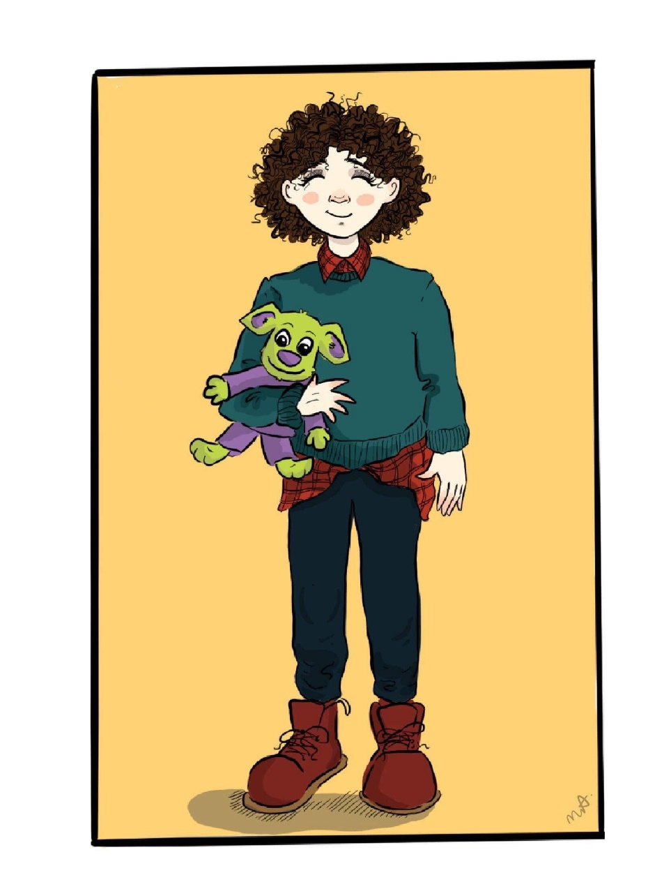
Spitting
We found out about this “spitting” strategy when I requested a copy of a BSP at secondary school and information from a FOI request.
This strategy had been agreed at primary school aged 11 years alongside team teach techniques that we were never consulted on. How would this make you feel if it was happening to you…what are we modelling to this young person?
“I found she used spitting as another strategy when she was at her most extreme-she would up the anti- and try to be disgusting-I saw it through and if she spat – I would wipe it up and wipe it back onto her.. we need to give that message that however extreme her behaviour becomes the outcome will not change- she will do what are asking because we are in charge”
Notes:
.

Slide 8
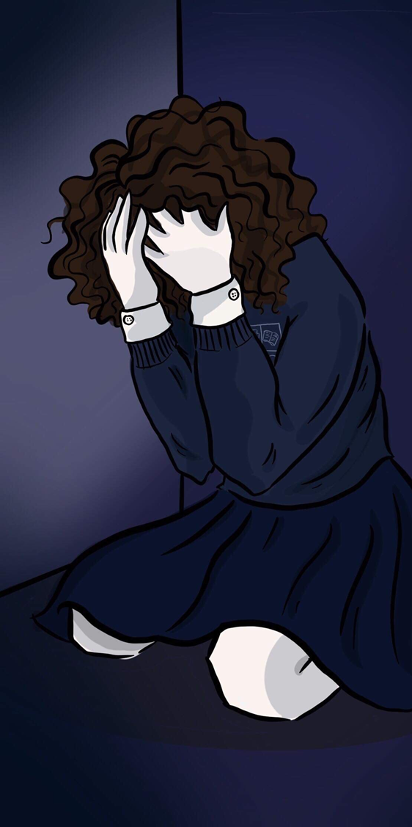
Complex Needs Unit- Secondary- Early transition.
What we knew and challenged
Witness to violence- she told us in her own way what she saw- would be distraught
Subjected to violence – pupil
Unexplained bruising- feet- whole body
Behaviours rocketed
Incontinence issues soared
Life narrowed as we were unable to understand or know how to cope with impulsivity- aggression, violent outbursts. Emotional deregulation – anxiety- obsessiveness- OCD.
We unpicked every event searching for triggers we desperately needed answers- it always came back to her diagnosis.
Notes:
.

Slide 9
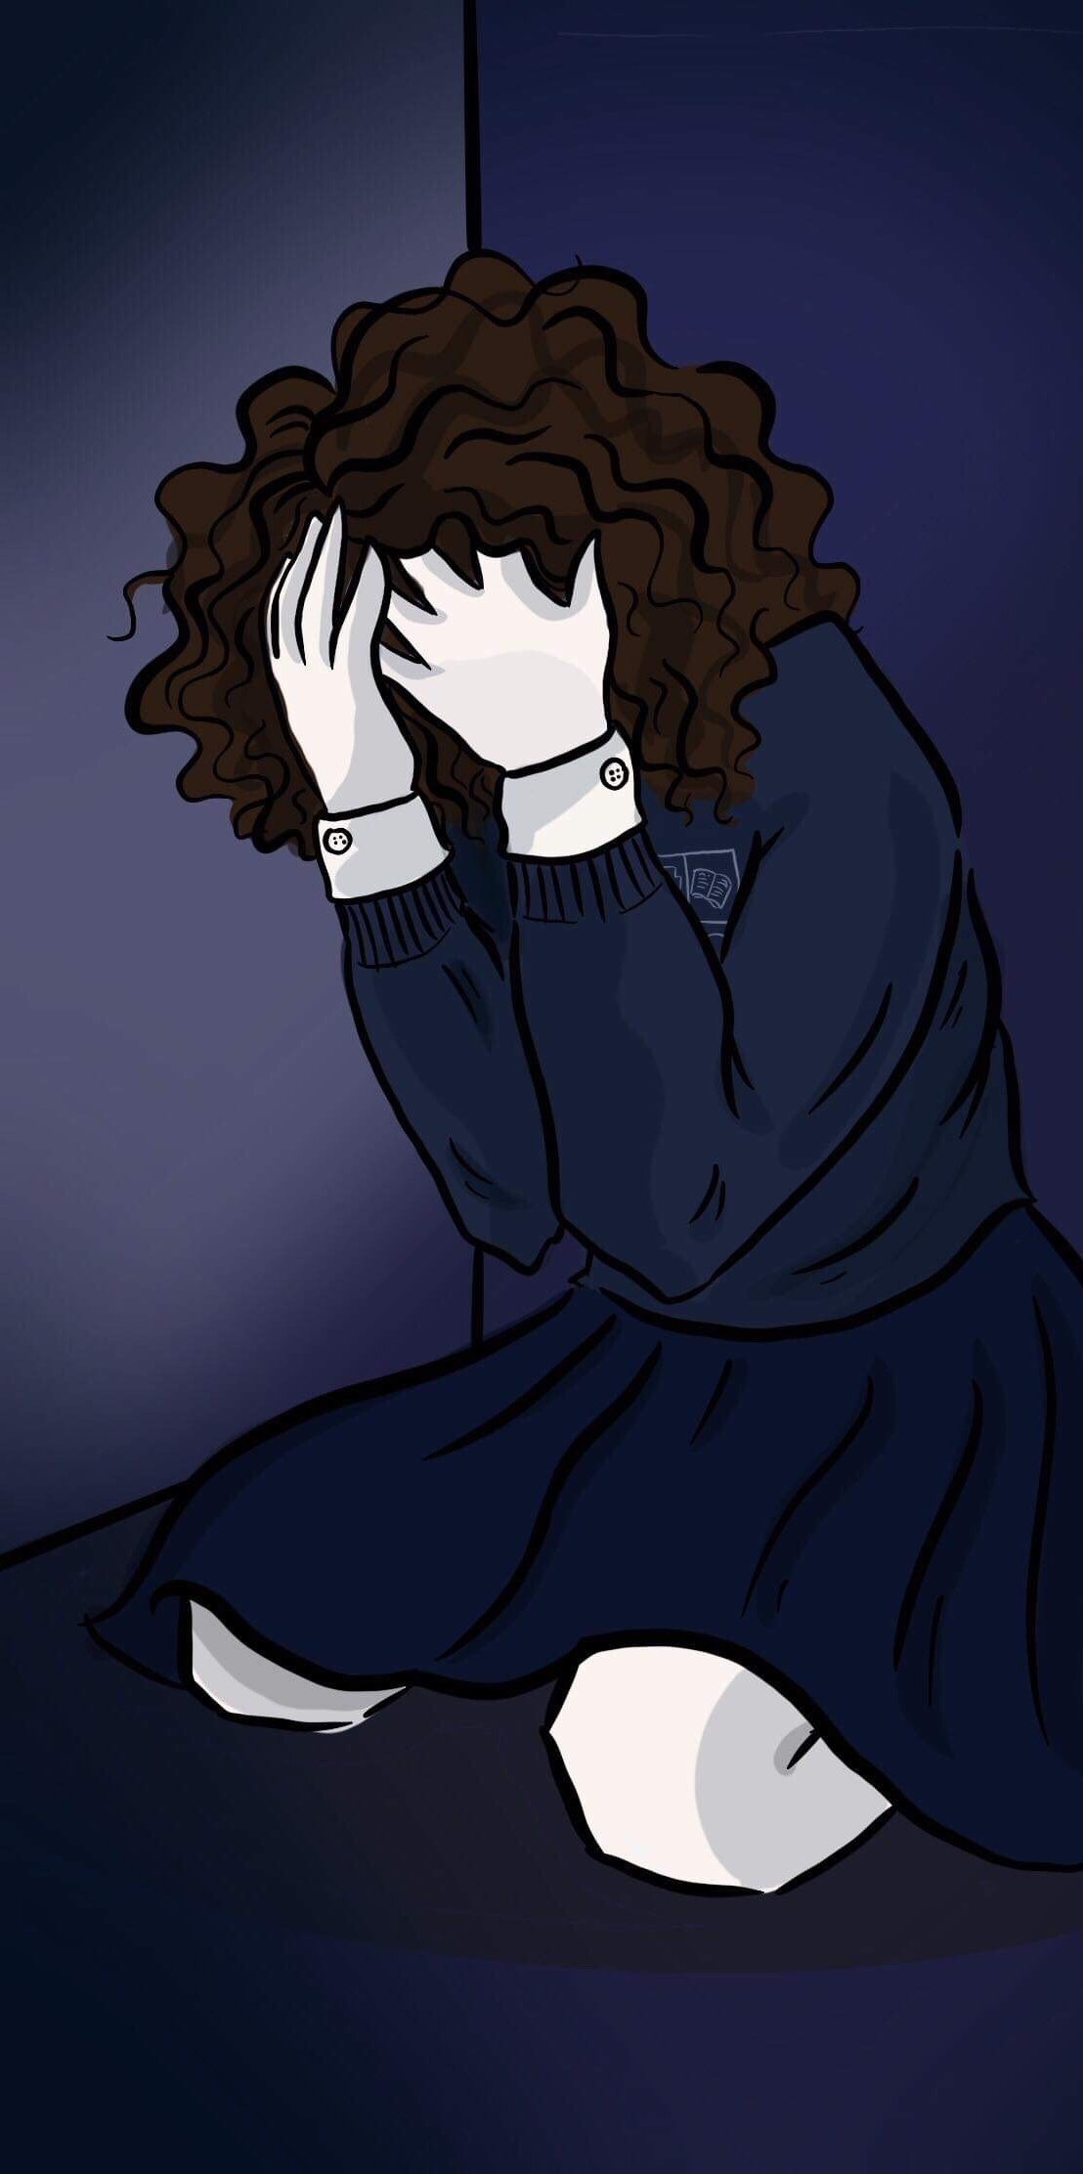
Complex Needs Unit- Secondary
What we found out
A pupil who wrote a note to their parents on Dec 17th 2017
That day she “was shut away as she was a bit edgy”- had PMT and they wanted to ensure she was calm before getting the taxi home. Major traumatic event for her- but not recorded as no big deal as this was part of her every- day life. Senior members of staff in school checked on screaming, kicking the door and walked away. Left physically spent and soiled- she was unwell when she came home.
Seclusion was used as punishment for non- compliance- a copy of her BHS was punitive-and driven by control the only outcome was seclusion. if you don’t go we will take you there.
Blue spaces were frequently used - 45 minutes a time-soiling and emotional distress.
Team teach methods used to take her to E13 a room- doors held shut- or locked with handles at the top and bottom of the door.
She was dragged across a stable floor at RDA for not wanting to get off the horse- reported to children’s services by a concerned member of staff.
Staff dismissing complex diagnosis believing she was a spoilt brat after a meeting with LD nurse- culture was toxic and harmful- no leadership or interventions to stop the cycle. Compassion and understanding gone.

Slide 10
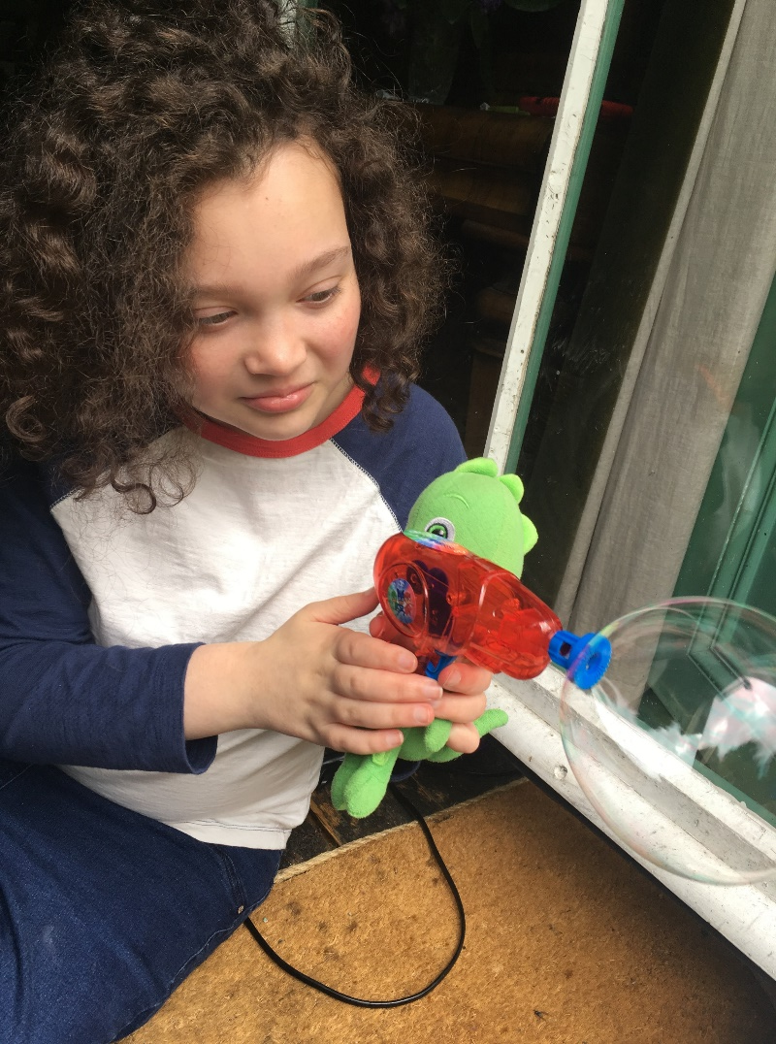
Impact
Life narrowed- triggers…voice, expressions, settings
She couldn’t manage a walk- “the bridge”
Anxiety became overwhelming
Needed to be in full control of her environment to feel safe
Couldn’t make decisions – hyperarousal- flight or fight.
No confidence – task avoidance
Created a support mechanism and coping skill to take the pressure of her..gecko did everything..
Antipsychotic drugs were being sold to us as a solution…

Slide 11
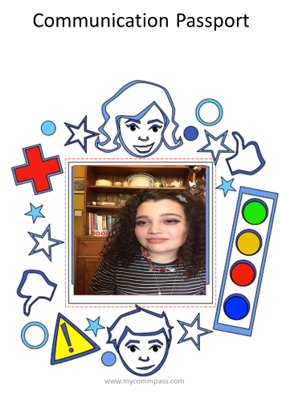
What happened next
We found it incredibly hard to trust anyone – but we were determined that her entitlement to be part of learning community like every other young person should not be taken away.
First step was to make it clear that the PBSS passport was to form an integral part of her care.
Creating this was a cathartic experience and very emotional..
We worked with Kathleen from (www.mycommpass.com)
There was to be no restraint or seclusion – no re-traumatisation
This was her voice..

Slide 12
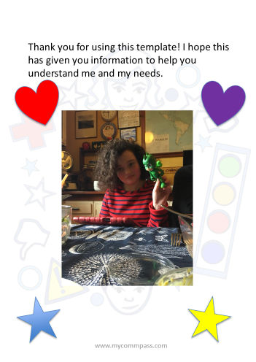
What happened next
After a few months of more “behaviours that challenge”- we were given an option to send her to a residential school as the placement had tried everything- we can’t support her. We refused and started to look again.
A crisis at her placement resulted in the PT reflecting and recognizing that nothing would change-until “she trusts us and feels safe”
That became the only priority- It was going to take time
Without that moment - the responses from my daughter would not change and the approach of the placement would not have been as successful

Slide 13
Strategies
Person centered PBSS
Understanding- what are the functions of her behaviours?
Investment of time and resources to help the recovery- Therapet
Relationship focused- small consistent team-rapport
Own environment- no closed doors- feeling of safety
Ability to join or not join activities- choice and control
Inhouse Teddy to make decisions..reassure
Clear consistent boundaries and use of language
Calm approach…tone of voice…
Gaining confidence to engage with others
Building on strengths and interests.
Steps toward regulating emotions and reducing stress. (Traveling by song )

Slide 14
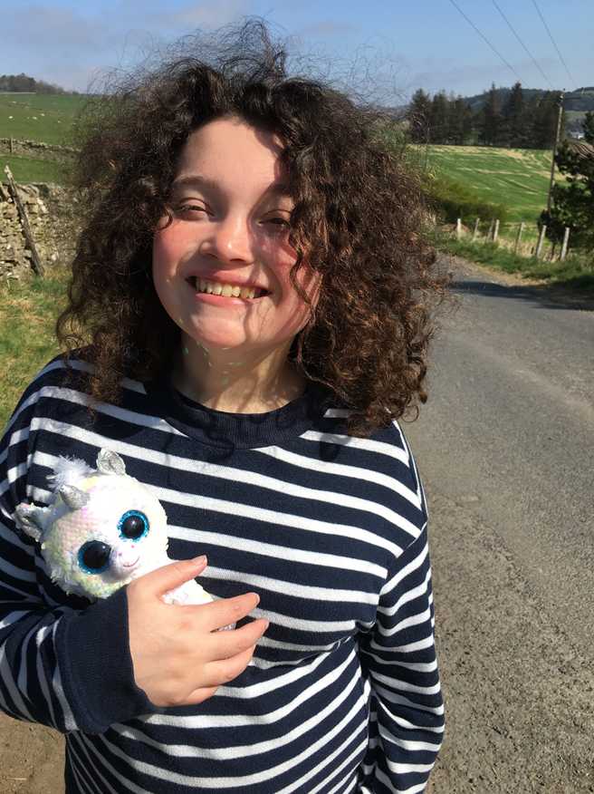
The Bridge…
I can walk over the bridge
I can take a message to the office and chat to staff
I can walk around the school without feeling cautious and scared ( I needed to always be physically supported)
I can make decisions about lunch
I can get in and out of the taxi (most of the time!)
I can join my peers in a class and leave if I am finding it hard to cope
I can trike to the local shop at school and get a message
I am beginning to trust
I can’t do these all of the time..

Slide 15
No restraint or seclusion.
There has been no incidences of restraint or seclusion in her current placement.
The ethos and culture adopted by the placement is totally different
There is leadership
There is compassion
The PT told me that my daughter has changed how they approach every young person
They also told me that she had taught them about relationships and about themselves.

Slide 16
Final Thoughts
I think every child with LD, ASD and complex needs should have communication passport (www.mycommpass.com)
It should form part of their journey from nursery to transition and be a part of their life
It shouldn’t be built from traumatic experiences but should be there to prevent them
All parents should know about the Children’s Commissioner and the rights of your child
Trauma informed practice and specific training should form part of a continuous programme of development for professionals involved in the care of vulnerable children, young people and adults.
We must always consider how we can make this better for everyone.

