Slide 1


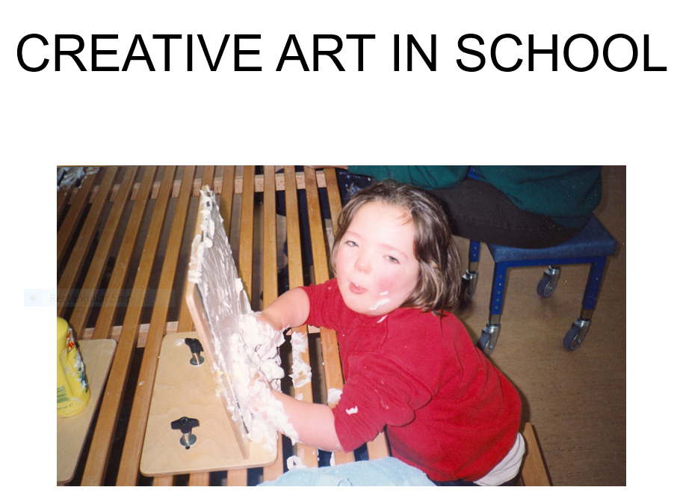
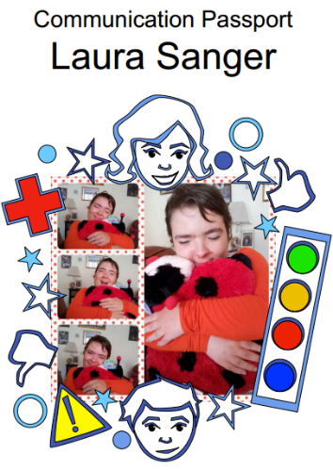
PBS Community of Practice for Scotland
IMPLEMENTING PBS IN FAMILY
SETTINGS
Kate Sanger (Family Carer)
C0-Creator of MYCOMMPASS
PABBS Trustee Advisor
CBF Trustee Advisor
www.mycommpass.com

Slide 2

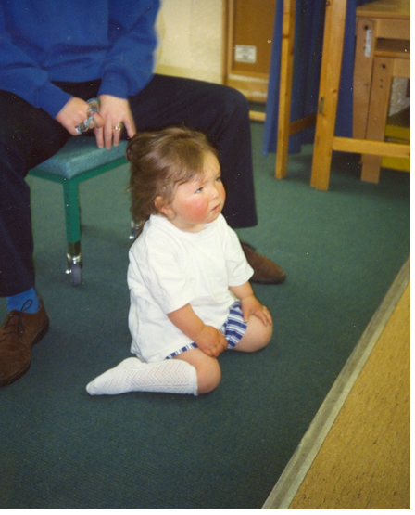
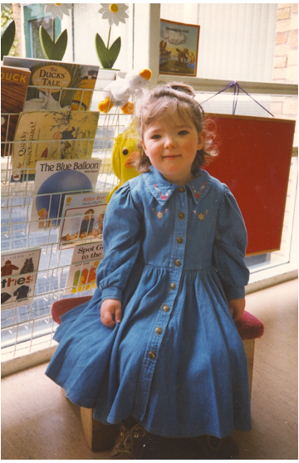
PRESENTATION
WERE PARENTS PIONEERS IN PBS ??
EARLY YEARS AT HOME & SCHOOL
WHEN WE GET IT WRONG (IMPACT ON LAURA & FAMILY)
WHEN WE GET IT RIGHT! (IMPACT ON EVERYONE)
WHAT HELPED US?
WHAT CHANGES DID WE PUT IN PLACE?
WHAT DO FAMILIES SAY
WHAT WOULD LAURA AND I LIKE FOR THE FUTURE

Slide 3

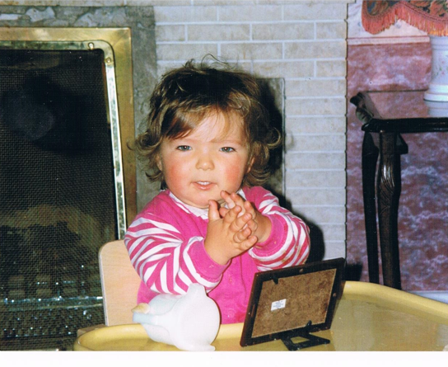
Were Parents Pioneers in PBS
EARLY YEARS
When you have a child with a learning disability, you ask yourself, will she/he walk, will they talk, or be able to look after themselves. Will she/he marry or be independent?
These are just some of my thoughts when I learned my child would be different!
What I didn’t ask myself or think about !
Would I have to change the :
Environment to meet her needs? Would I and others supporting her make her distressed because of the way we approached her? Would the tone of our voices cause her further distress? Would being frustrated make her
bang her head on the floor? and would her behaviour be her loudest voice ?

Slide 4
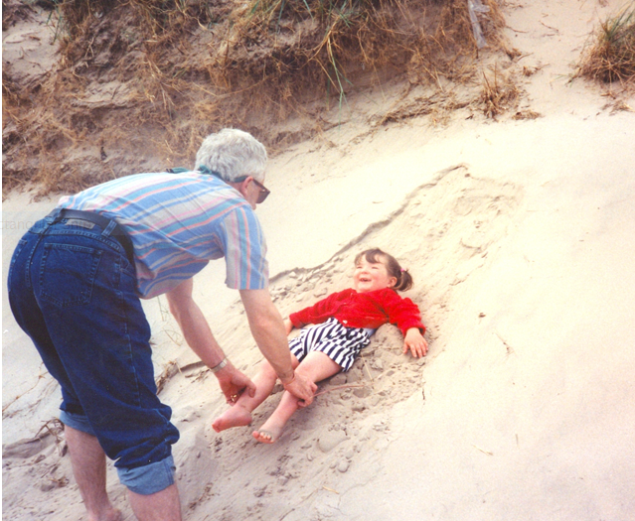
EARLY YEARS AT HOME & SCHOOL
Laura was the youngest of my three children, so I was experienced in understanding the usual milestones of behaviours and the rationale behind them; But Laura proved different, I couldn’t apply the same principles !
Laura would display quite disturbing behaviours such as hitting her face, biting her hands, throwing herself to the floor and banging her head.
As a parent, seeing my child in this state of distress was very upsetting for the whole family.
If a phone would ring she would hit out at the person beside her, if we gave her negative language e.g. Stop, Don’t, No, and
So on… she would get very angry and either hit herself or anyone within striking distance!

Slide 5
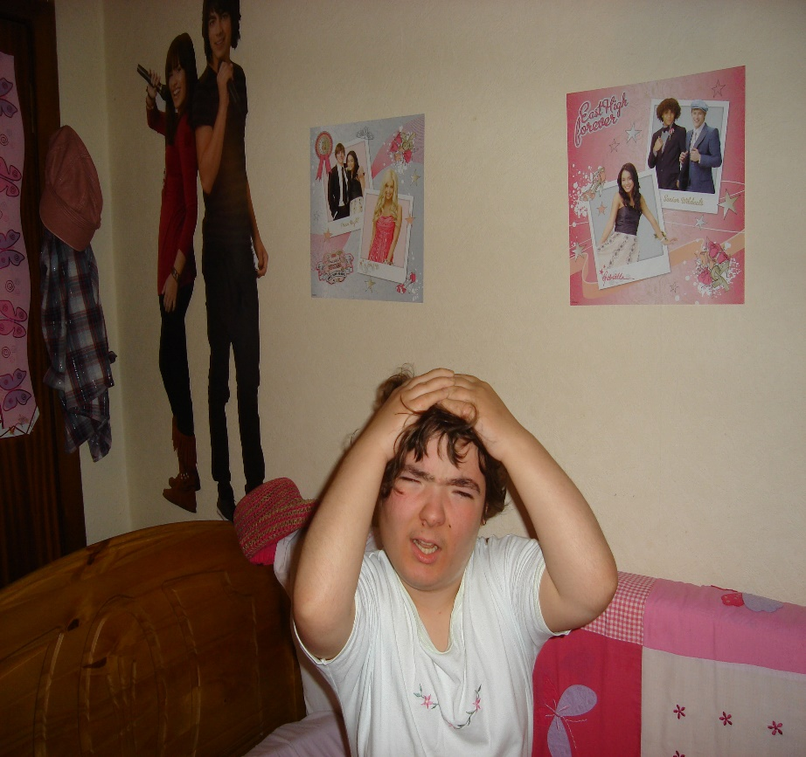
When We Got It Wrong(Impact on Laura)
We asked for help in coping and understanding why Laura was displaying such distressing behaviours, at the time we met with professionals that wanted to medicate and tried to put the reason for her behaviours all down to her learning disability!
I eventually changed the environment to met Laura’s needs, so phone was switch to quiet mode when she was about, we stopped using negative language, instead of No or Not Now, we would say ‘in a minute’ or ‘later Laura’.
We stopped saying “Why is she doing this” and we changed it to “What is she trying to tell me with this behaviour” I started to look at the behaviour differently, tried to work out what she was trying to achieve, was she trying to escape the task, or was she uncomfortable, or in pain?
I didn’t know this was the start of my PBS journey, trying to improve Laura’s happiness and quality of life.

Slide 6
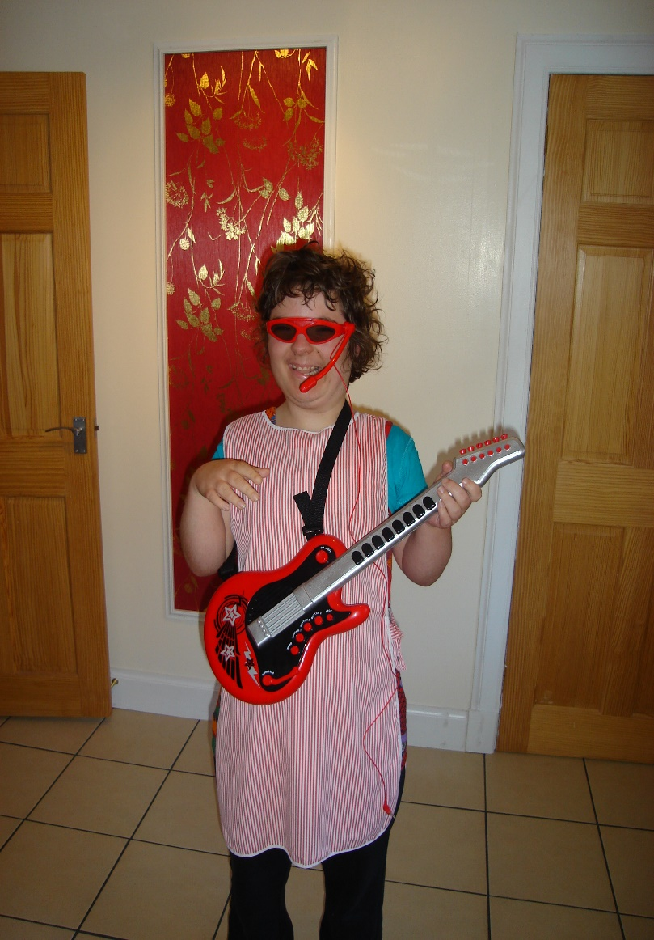
When We Got it Right! Impact on all involved
Laura’s Life.
After years of doing all the wrong things and resulting sometimes on making the situation worse, I went on to trying to put positive strategies into Laura’s support, we were introduced to the Challenging Behaviour Foundation who made me realise that it was not about changing Laura! But looking at things within her environment, helping her communicate more effectively, and supporting those involved in her care to understand Laura,, and meet her needs in a positive way by understanding that all behaviours happen for a reason, and Laura is trying to convey something is not right, and she is trying to tell you the only way she know how.
Ask yourself is my approach or my tone of voice making the situation worse for this person?
Remember behaviours that challenge is away of letting you know this person is feeling distressed, and there is always a reason!

Slide 7

What helped us? What Changes Did We Put
In Place?
We put Laura at the core of every thing which involved her.
We developed and made her a Communication Passport which gives her a voice.
This allows her needs to be expressed in a way that reminds everyone they are dealing with a young adult who is trying to communicate with them in ways that they might not have otherwise recognised.
It is a totally person centred plan
Based on positive and proactive strategies.
The Passport shows others how Laura would like her life to be.
By informing the reader of ways to support positive behaviour, the Passport promotes care that lets Laura feel and act her best.
As Laura’s Passport contains clear information on the best ways to deliver good practice, any negative incident must be reflected on in relation to what should have been done and what can be done in the future.
Laura’s Passport is a teaching tool for staff, it gives the confidence and job satisfaction that they are doing their best for the person they support.

Slide 8

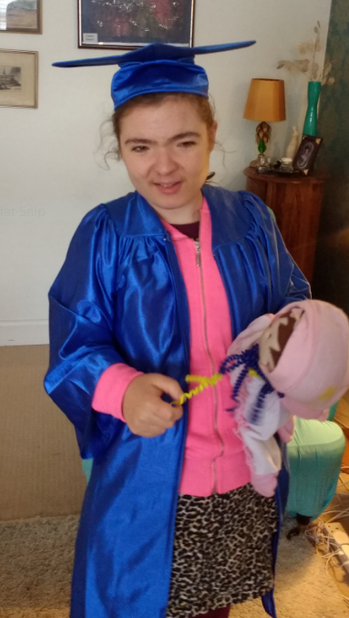
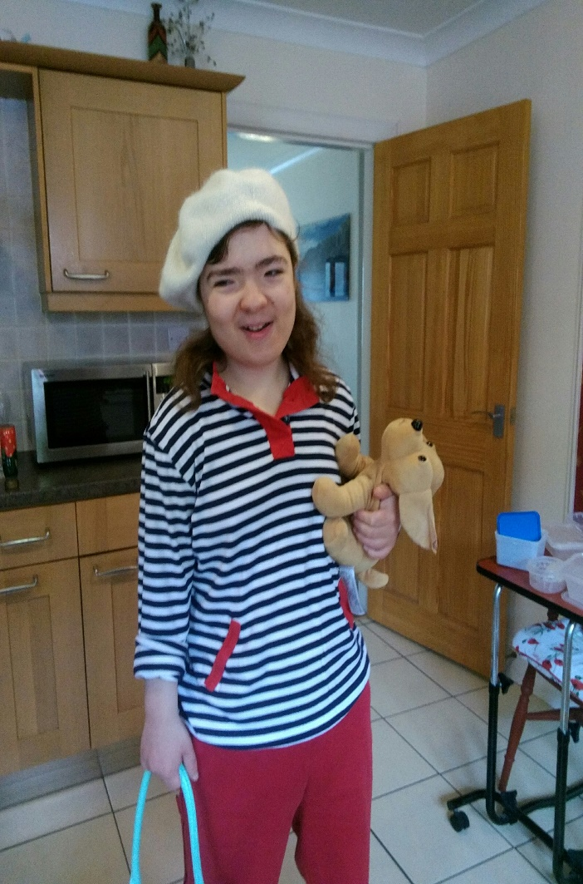
WHAT DO FAMILIES SAY?
It has been a long and at times a lonely journey to get what is necessary for Laura; All I want for Laura is a future where she will have a voice and be heard, a life that will be valued, a safe secure happy future that is fulfilled, just the same any other parent would want for their son or daughter.
My daughter should not have to self-injure or hit out to let you know she is in pain, or anxious, over-stimulated, frightened or thirsty or hungry.
Now I understand that there is a better way to support Laura in a positive proactive way without her resorting to distressed behaviours to get her needs met.
Families and Professionals deserve to have the right training in promoting a positive way for the person they support.
It shouldn’t have taken me years to get to the happy place Laura and I are now!
Laura is now a happy girl who is valued for the unique individual that she is.

Slide 9

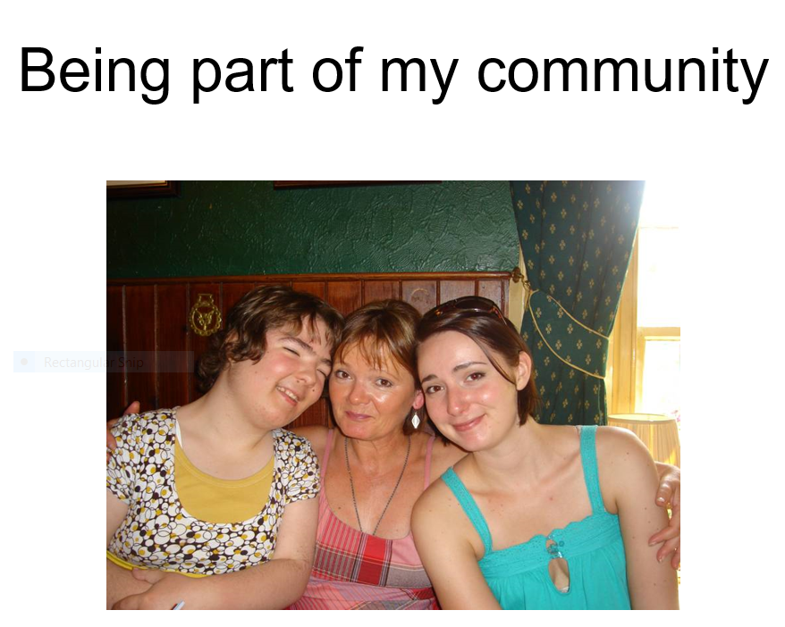
WHAT WOULD I LIKE FOR THE FUTURE!
>Laura to have the same rights as everyone else.
Children/Adults with learning disabilities have a voice
And have it heard!
A person centred positive support plan
All staff involved in the support of Children/Adults trained in Positive Behaviour Support
All staff supported to feel happy that they are doing the best job they can
Training and support for parents in Positive Behaviour Support and continued follow up to show that the system cares about them and their child.

Slide 10

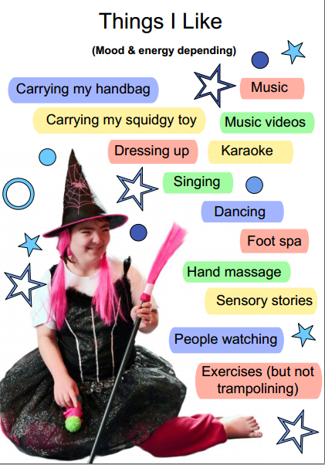
Thank-you everyone for taking the time to listen, stay safe.
Kate & Laura

