Slide 1
PBS Community of Practice for Scotland
Launching the PBS Community of Practice for Scotland
Dr Anne MacDonald
University of Glasgow & Scottish Government

Slide 2
PBS Community of Practice for Scotland
Plan for Today’s Webinar
1. What is PBS and What is the PBS Community of Practice for Scotland? Dr Anne MacDonald, University of Glasgow & The Scottish Government
2. Implementing PBS in Family Settings Kate Sanger, family carer & Trustee from PABSS
3. Implementing PBS in Social Care Settings Caroline Shaw, Head of Complex Needs, The Richmond Fellowship Scotland
4. Implementing PBS in Healthcare Settings Dr Jill Jones, Consultant Clinical Psychologist, NHS Fife

Slide 3
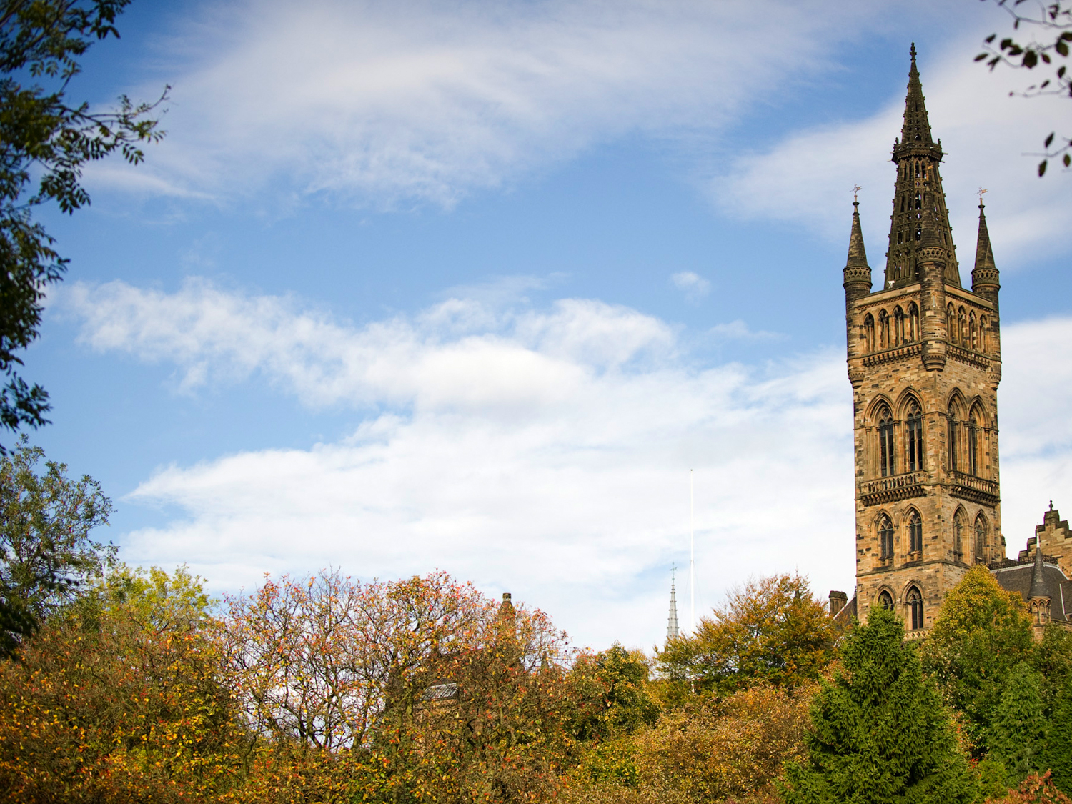
What is Positive Behaviour Support?
What is the PBS Community of Practice for Scotland?
Anne.MacDonald.2@Glasgow.ac.uk

Slide 4
An Accessible Description of PBS

Slide 5
1. PBS is Values Led
Person-centred values and beliefs underlie PBS
PBS is non-aversive, so does not use any punishment-based approaches
PBS is respectful and all interventions developed must be socially valid
PBS planning involves the person’s family & friends in agreeing the support plan
The support plan must take account of the values, skills & resources of the staff who will be implementing the plan; it must make sense to them

Slide 6
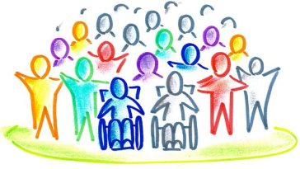
2. PBS Promotes Quality of Life
This is the main goal of PBS; we have an obligation to ensure our support achieves a better life for the person
This is non-contingent, so does not depend on the person’s behaviour or them ‘behaving well’
PBS has a long-term focus to achieve lasting changes and improvement in a person’s life
This includes improved relationships, increased community integration, greater self-confidence, increased choice, improved skills and greater life opportunities

Slide 7
3. PBS Works to Understand Behaviour
Understanding the message of the person’s behaviour is always the starting point
Interventions will include changing the environment, as well as teaching the person new skills
There will be separation between proactive approaches which change behaviour over time, and reactive approaches which only respond to emergency or crisis situations
Evaluation should be ongoing to ensure we are getting the support right for people and that it is resulting in improvement

Slide 8
4. PBS is Committed to Systems Change
PBS is based on a belief that meaningful and lasting change is only possible if organisations and systems around people are changed
This may mean that staff will need training and may also need to be supported differently
There may need to be new roles developed, e.g. practice leaders to lead on PBS
Organisational policies and processes may need to change
A good PBS plan is not enough!

Slide 9
PBS Levels of Support
Few
Some
All
Level 3: Intensive Individualised Support
Based on in-depth functional assessment
Individual comprehensive PBS plan
Data collection and individual monitoring
Level 2: Specialist Support
Simple behavioural interventions
Additional support in key areas
Function-based strategies
Level 1: Universal Support
Person-centred and predictable environments
Active Support and participation in activity
Environments which support communication

Slide 10
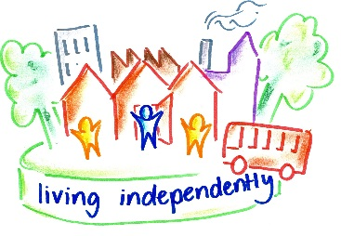
What is the PBS Community of Practice for Scotland?

Slide 11
Background to the PBS Community of Practice
The Scottish Government commissioned a report to look at the issue of out-of-area placements and delayed discharge for people with learning disabilities and complex needs
One of the recommendations of the Coming Home report was to set up a PBS Community of Practice for Scotland
In The keys to life Implementation Framework the Scottish Government made a commitment to invest in the development of PBS

Slide 12
What is a Community of Practice?
A Community of Practice is a group of people who have a common interest, and who want to come together to share that interest
The aim is to learn from each other, to share resources, and to engage in discussions and dialogue – to promote PBS and improve quality of life for people with learning disabilities in Scotland
Everyone is welcome!

Slide 13
How the PBS Community of Practice will Work
While we cannot meet face to face, we plan to deliver a series of regular webinars, covering all aspects of implementing PBS in a range of settings
We hope that this will be a starting point for PBS discussions and development across Scotland
We want as many people as possible to join in, to share their experiences, and help us all learn from each other

Slide 14
What’s Next for the Community of Practice?
We know the community will work best if members get engaged and involved
So we will also be setting up a website for the community to share resources and good practice
And after today’s webinar, you will have a chance to sign up to join the PBS Community of Practice – we hope that many of you will do that

Slide 15
Thanks for joining us today!
Look after each other, and stay well!

