Slide 1


Self-Directed Support, Human Rights and People with Learning Disabilities
Charlie McMillan
Chief Executive, Scottish Commission for People with Learning Disabilities (SCLD)

Slide 2
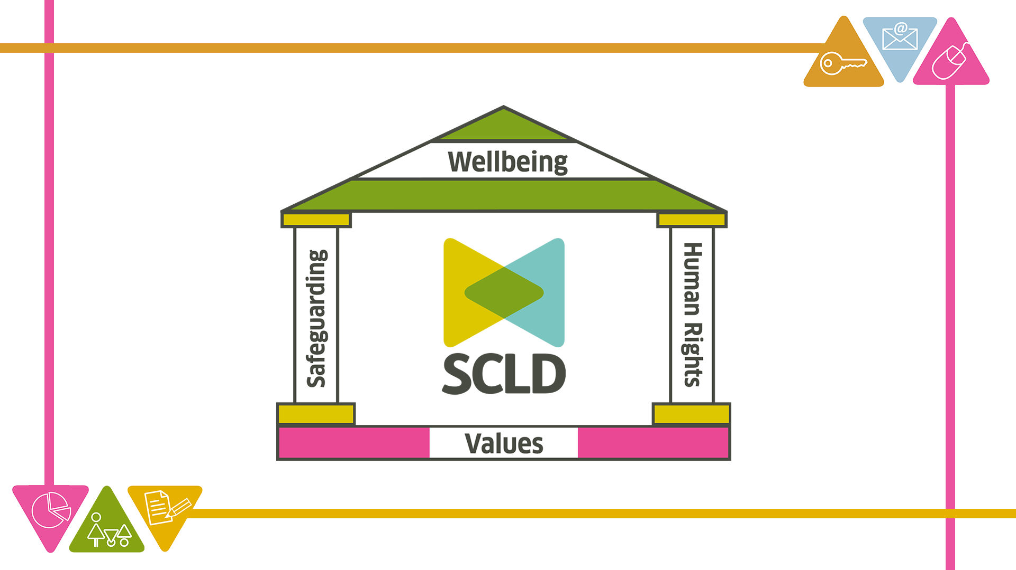
Notes:
Linda

Slide 3

SCLD’s values
We are…
Respectful - We respect people with learning disabilities, one another and everyone we come into contact with.
Inclusive - We are a place where everyone belongs, no matter who they are, or what barriers they face.
Collaborative - We value working with others. Everyone has something to give and everyone is given the opportunity for their voice to be heard.
Pioneering - We are not afraid to take risks or to enable people with learning disabilities to take risks.

Slide 5

Social Care and Human Rights
SDS has a key role in protecting and promoting human rights through supporting people with learning disabilities:
to enjoy their right to live independently and to be included in the community (Article 19 UNCRPD)
to participate in and contribute to economic, social, civic and cultural live as active citizens

Slide 6
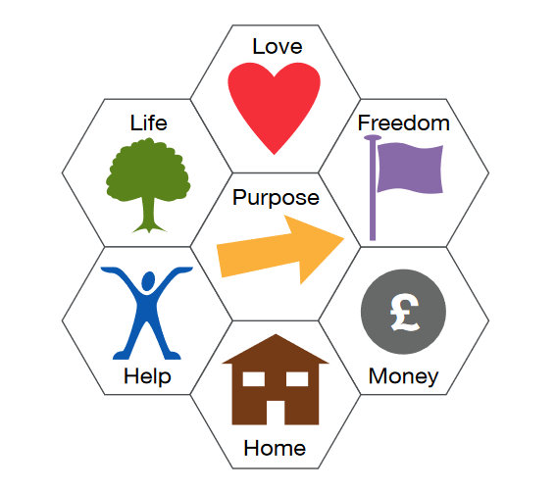
Seven Keys to Active Citizenship
Sly & Tindall (2016) Citizenship. Centre for Welfare Reform

Slide 7

Fairer Scotland for Disabled People
The Scottish Government’s Fairer Scotland for Disabled People Delivery Plan take a rights based approach based on the UNCRPD and has five long-term ambitions;
Support services that promote independent living, meet needs and work together to enable a life of choices, opportunities and participation.
Decent incomes and fairer working lives.
Places that are accessible to everyone.
Protected rights.
Active participation.

Slide 8
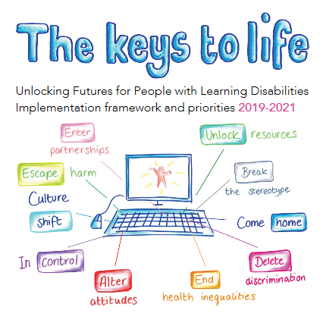
The keys to life learning disability strategy
Human rights, whole system, whole population, whole person approach
Living, Learning, Working, Wellbeing
A Healthy Life, Choice and Control, Independence, Active Citizenship

Slide 9
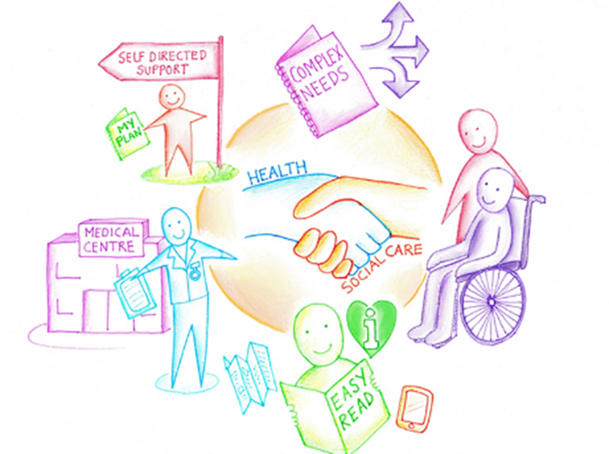

Self-Directed Support
Freedom, Choice, Dignity and Control
Personalisation (people and families having choice and the ability to shape and control the services they require)
Co-production (equal and collaborative relationships between people, families and professionals).
Personal Outcomes

Slide 10
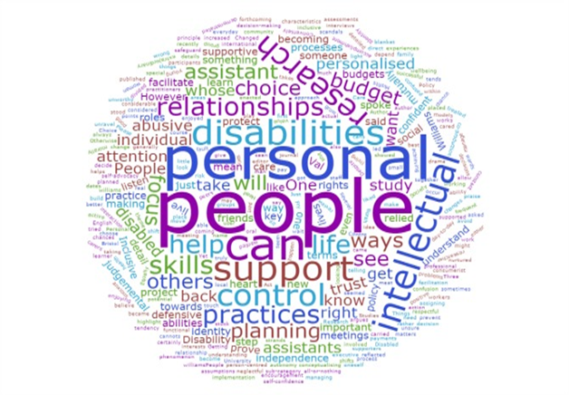
Independent Living: Choice and Control over SDS
People with learning disabilities may require additional help to exercise choice and control over how their support needs are met, and how their support is provided to meet their personal outcomes including:
Access to good quality information, advice and assistance in understanding SDS options
Access to supported decision making and independent advocacy
Support to know the budget and resources available and to use these creatively and flexibly
Support to understand how and why decisions about budgets and support are made
Support for the development of innovative delivery mechanisms that allow people to pool personal budgets and in peer-support via user-led organisations

Slide 11

Barriers to Self-Directed Support
Not everyone is getting the choice and control envisaged by SDS
There is a lack of awareness of SDS options among people with learning disabilities and their families
Information is not always communicated in a way that meets people’s needs
People are not always fully engaged in assessment support planning and consideration of their options
People report being told that SDS budgets can’t be used for certain purposes.
There can be particular problems in accessing SDS for those with complex needs
There is significant variation in the way SDS is delivered across local authorities
Access criteria for SDS operates differently in each of the 32 local authorities and thresholds for eligibility have increased over the past decade

Slide 12


Ian’s Story

Slide 13
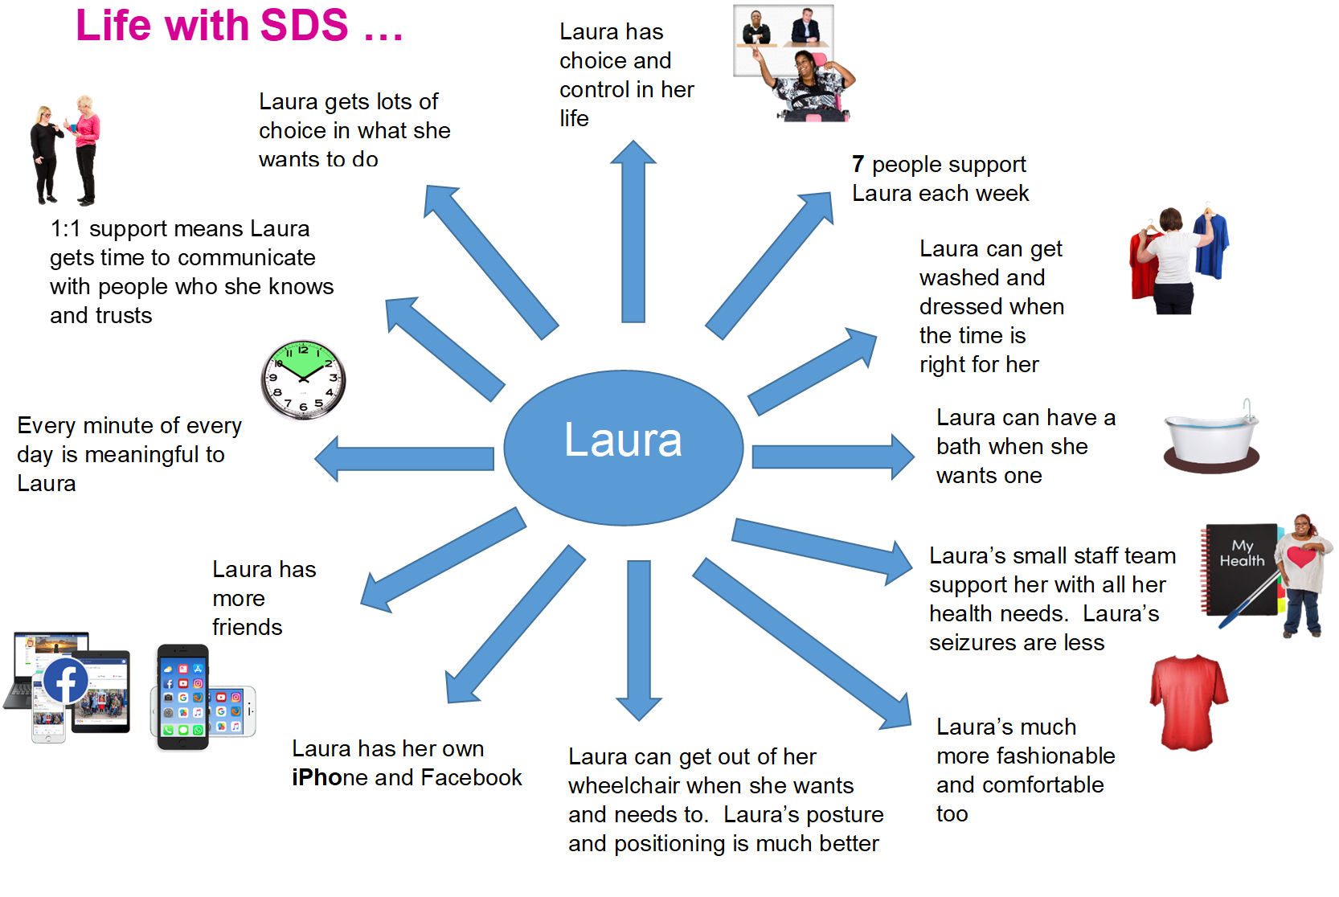

Slide 14

Charlie McMillan
Charlie.M@scld.co.uk
0141 248 3733 www.scld.org.uk
Questions

