Slide 1
Scottish Commission for Learning Disability
1St Employment Task Group Meeting
7 February 2017
Glasgow Caledonian University

Slide 2
Scottish Commission for Learning Disability Employment Task Group
Welcome and Introductions – Jim Mc Cormick, Chairperson
https://www.facebook.com/projectsearchuoa/videos/vb.1454906794736957/1656145194613115/?type=2&theater

Slide 3
Scottish Commission for Learning Disability Employment Task Group
Opening Remarks
Ms Maureen Watt MSP Minister for Mental Health

Slide 4
DOING BETTER ON EMPLOYABILITY FOR PEOPLE WITH LEARNING DISABILITIES IN SCOTLAND
7 February 2016
Alan McGregor

Slide 5
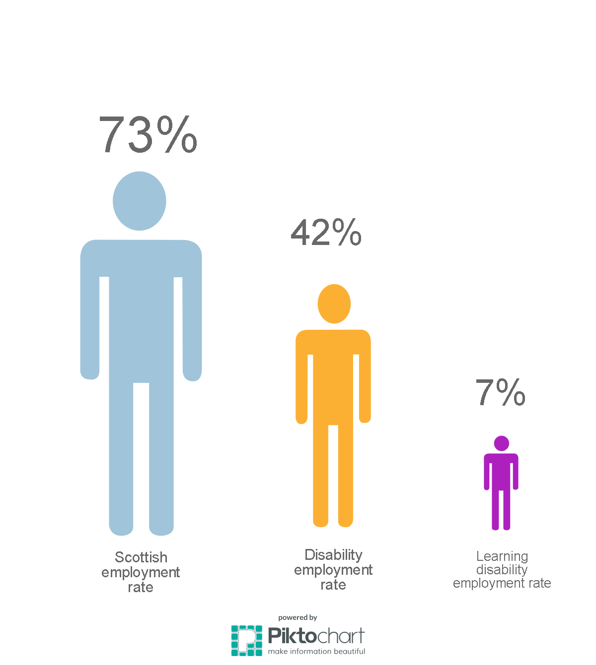
Employment Rates of People with a Learning Disability

Slide 6
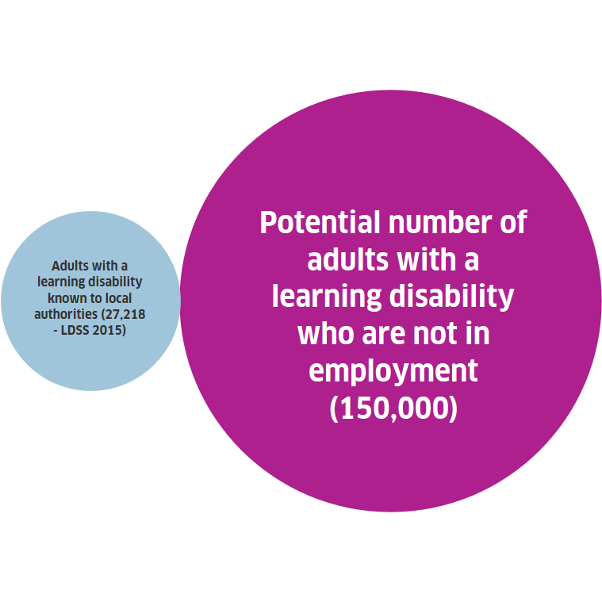
Population

Slide 7
Range of Factors Involved
Parental expectations and concerns
Education system (see next slide)
Employer perceptions and attitudes
Complex needs to be addressed

Slide 8
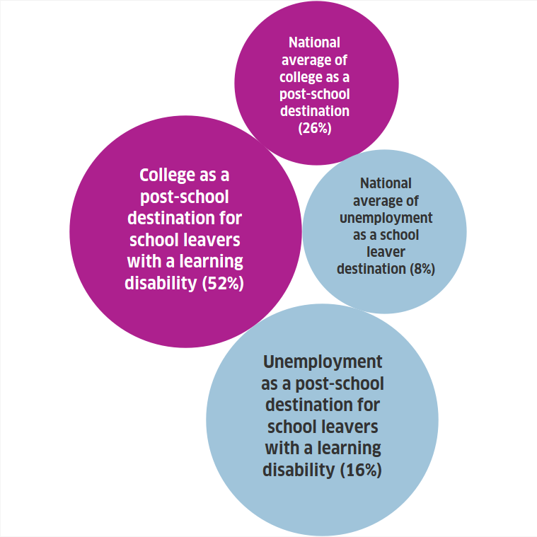
Societal Factors – The Education System

Slide 9
Recommendations for All Learning Disability Partners
Substantially improve recording and reporting of learning disabilities data.
Establish more effective joined-up employment pathways for people with a learning disability.
Double employment outcome rates for people with a learning disability to 50% over a 5 year time period.
Secure extra resources/funding for learning disability employability services.

Slide 10
Recommendations for Scottish Government
Give greater priority to employability/employment of people with a learning disability.
Renewed promotion of the Supported Employment Framework, working closely with SUSE, SDS, SFC and local authorities.
Set Scotland’s employers the target of 4% of employees to be people with a learning disability.

Slide 11
Recommendations for Local Authorities
Develop directories of employability services for people with a learning disability.
Establish Supported Employment Services in all local authority areas.

Slide 12
Recommendations for Skills Development Scotland
Collect and report learning disability data so that people accessing MAs, national programmes and employment can be monitored and reported.
Embed learning disability good practice in its contracted provision with providers of SDS programmes promoting the Supported Employment Framework as best practice.
Set higher targets for providers working with people with a learning disability.

Slide 13
Recommendations for Scottish Funding Council and Scotland’s Colleges
Greater focus on progression into real, sustainable employment. This may require more developed joint working with employers so that learners are developing skills in real workplaces not just college settings.

Slide 14
Recommendations for SCLD
Continue to profile and promote learning disability employment and employability, its challenges, and the positive social and economic value of supporting people into real sustainable employment.
Develop agreed definition of ‘learning disabilities’ so that funders, organisations and employers are clearer who is included and who is not.

Slide 15
Recommendations for Employers
Increased employer commitment to recruiting people with a learning disability.

Slide 16
Scottish Commission for Learning Disability Employment Task Group
Key Challenges
Overcome the low expectations held by parents, schools, colleges and employers.
Gather data more effectively, investing funding where people with a learning disability in Scotland secure both employment and support to develop in that job.
Use this data to invest in post-school funding into services that can deliver employment outcomes of 50% as detailed in the report.
Recruit and train Job Coaches that can support people with a learning disability into employment and throughout their careers. Recognising Job Coaching as a profession that has quality standards that are monitored nationally.

Slide 17
Scottish Commission for Learning Disability
LEARNING DISABILITY AWARDS
LEARNING DISABILITY WEEK 2017
https://vimeo.com/194359736
https://vimeo.com/194359707

Slide 18
Definitions
People with learning disabilities have a significant, lifelong condition that started before adulthood, which affected their development and which means they need help to: Understand information; learn skills and cope independently.
People with complex learning disabilities are defined as having cognitive impairment and multiple health needs, alongside coexisting difficulties including physical disabilities, sensory impairment, mental health needs, developmental disorders, challenging behaviour and/or communication difficulties. They require long-term, high levels of support in many aspects of daily living.

Slide 19
Scottish Commission for Learning Disability Employment Task Group
Sum up, next steps – Jim McCormick, Chairperson
Thank you

