Slide 1




Supporting Parents With a Learning Disability – Where Are We Now?
Welcome

Slide 2
The keys to life Recommendation 38:
“that by 2014 parents with learning disabilities should have access to local supported parenting services based on the principles of Supported Parenting and that the Scottish Good Practice Guidelines for Supporting Parents With Learning Disabilities are being followed by professionals… to ensure better outcomes for families”

Slide 3


Parents with a
Learning Disability
Developments
and Pathway
Alan Roberts - Service Planning and Development Manager
Dr. Eleanor Porter – Clinical Psychologist

Slide 4
Context
Research completed 2010
Recommendations:
More joined up approach focussing simultaneously on needs of parent and baby – from statutory and commissioned services
Better targeting earlier in pregnancy journey
Workforce capacity and development issues-
Practitioners without specialist LD knowledge and skills not confident to refer to specialist services without a pre existing diagnosis

Slide 5
Keys To Life – Recommendation 38
That by 2014 parents with learning disabilities should have access to local supported parenting services based on the principles of Supported Parenting and that the Scottish Good Practice Guidelines for Supporting Parents with Learning Disabilities are being followed by professionals working with parents with learning disabilities to ensure better outcomes for families

Slide 6
Where we are
Multi-agency group formed
Action Plan created
Most actions follow on from creation of pathway
Pregnancy pathway developed
Successful bid made to Scottish Government to support Parents with a Learning Disability through provision of enhanced support from Family Health Project (FHP)

Slide 7
Where we are
Specialist parenting programmes being implemented for a range of vulnerable groups including LD
Mellow bumps and mellow babies has been co-ordinated Fife wide via Fairer Fife monies
Parenting resources now available
from Health Promotion

Slide 8



Parenting Resources
Notes:
My Pregnancy My Choice
Uses easy words and pictures and covers all aspects of antenatal care; knowing if you are pregnant, your developing baby, problems during pregnancy and the first days with your baby.
You and Your Baby 0-1
Easy-read book aims to support parents to take care of their growing baby and covers feeding, hygeine, types of foods, safety, teething, health checks and managing routines such as changing and sleeping.
You and Your Little Child 1-5
Covers healthy eating, making meals, hygeine, potty training, play and learn, nursery and routines such as bathing and bedtime.
Available from NHS Fife Information and Resources Centre,
Health Promotion, Haig House, Cameron Hospital, Leven.
Tel: 01592 226494. Email: Louisehutton@nhs.net

Slide 9

Key features of good practice
(Good Practice Guidance on Working with Parents with learning Disability, DoH and DES, 2007)
Accessible information and communication
Clear and coordinated referral processes, eligibility criteria and care pathways
Support designed to meet the need of parents and children based on their strengths and needs
Long term support where necessary
Access to independent advocacy
Notes:
Reflect briefly on the good practice guide

Slide 10


LD Pregnancy Pathway
Confirmation of pregnancy – Hubs, GP, MW, Pharmacy, Home Test
Referral to MW/GP/ to discuss choices
If appropriate refer to FNP
Accessible information provided via referral to CLDT
Refer to FHP - Inform HV
Suspect LD - Complete screening tool to assist with identification of LD
Refer to Barnardo’s Support Worker
If LD diagnosed or suspected and there are identified needs. Refer to CLDT CPA may be offered to support parents with LD
TOP [Termination Of Pregnancy]
If Child Protection concerns present, complete unborn Child Risk Assessment:
Continue with pregnancy
Spontaneous miscarriage
Refer to Social Services C&F
Early home booking by MW
Refer to GP
Referral to counselling ( CLTD ) if required
12 week scan
TOP Clinic Family Planning Advice
Explain, offer and refer for advocacy support
At 20 weeks gestation / 20 week scan
Refer to counselling (CLDT) if required
22 weeks: Multi-agency meeting
kEY
HUB Sexual Health Clinic
GP General Practitioner
MW Midwife
FNP Family Nurse Partnership
FHP Family Health Project
HV Health Visitor
CLDT Community Learning Disability Team
C&F Children and Families Team
Additional services required:
Appoint key worker
Co-ordinate care plan to provide an effective/efficient streamlined service with good inter-agency communication and liaison
No additional services required. Continue to provide antenatal / intrapartum and postnatal care

Slide 11
Learning Disability
Relationships & Sexual Wellbeing
Service Developments
Learning Disability
Health Improvement
Stakeholder consultations 2010
LD Health Improvement Strategy Launch
May 2011
key theme Relationships & Sexual Wellbeing
for People with Learning Disabilities
Making Choices Keep Safe:
Multi Agency Best Practice Guidance
May 2013
Level 1: Awareness Training
Making Choices, Keeping Safe
– 1 day course
2009 – present
Sexual Health Toolkit
Oct 2014

Slide 12
Family Health Project
  The rationale for the Family Health Project is based on the premise that health inequalities are set in the very earliest years of a child's life, even before birth. A number of factors can impact on a child’s health for example, nutrition, stress and health harming behaviours of mothers.
  The period between 0 and 3 years is a critical window for shaping life chances and is a key area of focus in the Scottish Government's Early Years Framework.
  Early intervention approach to reducing health inequalities, and so is particularly aligned with the Early Years Framework.

Slide 13
Principle Objectives
Improve maternal & child health outcomes in the most economically deprived areas of Fife
Stabilise substance misuse
Improve parenting
Strengthen parent & child bonding
Improve breast feeding rates
Reduce maternal smoking
Increase multi-agency support
Enable effective risk assessment

Slide 14
Developments
Links with Learning Disability (LD) teams
Family worker from Barnardo’s links with families with LD
One to One support during pregnancy and beyond
Child protection assessment continuous beyond birth
Engages with Mellows programme

Slide 15
Process
Parent needs assessed and agreed
One to one visits from named midwife
Liaison with other professionals as identified
Complete Learning Disability Screening Questionnaire for all
Linked with Barnardo’s if Learning Disability known or suspected
Parenting needs identified and support from nursery nurses given
Involvement with groups in family centres
Integration with local services beyond pregnancy

Slide 16
Challenges
Increasing demand
Child protection impact
Nursery nurse boundaries –letting go!
Sharing information – more always wanted!
Communication with other professionals
Continued funding in current fiscal climate

Slide 17
Identifying individuals with a LD
The nature and length of professional support could be crucial in helping people to become ‘good enough’ parents (Cleaver and Nicolson, 2005).
To provide timely and appropriate support, it is important to identify that an expectant mother or father has LD as early as possible.
Parenting interventions can be successful at improving targeted skills (Wilson, 2014) but support for this group may often occur in the context of a crisis (Ward & Tarlton, 2007)
Working in a planned, proactive way increases the opportunity for parents to show they can be ‘good enough’ (Porter et al, 2012)

Slide 18
Assessment of Learning Disability
or full diagnosis to be made, the person must undergo assessment by a Clinical Psychologist.
This involves assessment of intellectual functioning, adaptive functioning and a developmental history to ascertain whether they have:
Significant impairment in intellectual functioning (IQ of <70);
Significant impairment in adaptive functioning;
Childhood onset of these impairments (BPS, 2000).
These assessments are time consuming to administer...

Slide 19
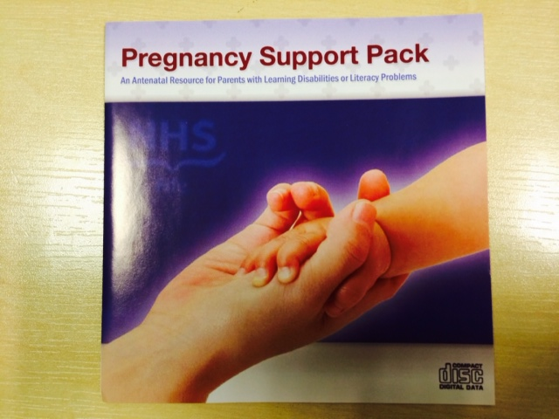
Pregnancy Support Pack
Accessible resources used by NHS Fife

Slide 20
Pregnancy Support Pack
Developed in 2012.
Resources were developed by the Speech and Language
Therapy Department within NHS Fife primarily for use by
the midwifery service.
All information that the midwifery service would routinely give to
mothers from the general population during a typical
pregnancy was adapted to be accessible to pregnant women who have a learning disability and/ or literacy problems.
This included symbolised appointment letters, consent forms, accessible information on antenatal scans, where to access help, birth plans and information on labour.

Slide 21
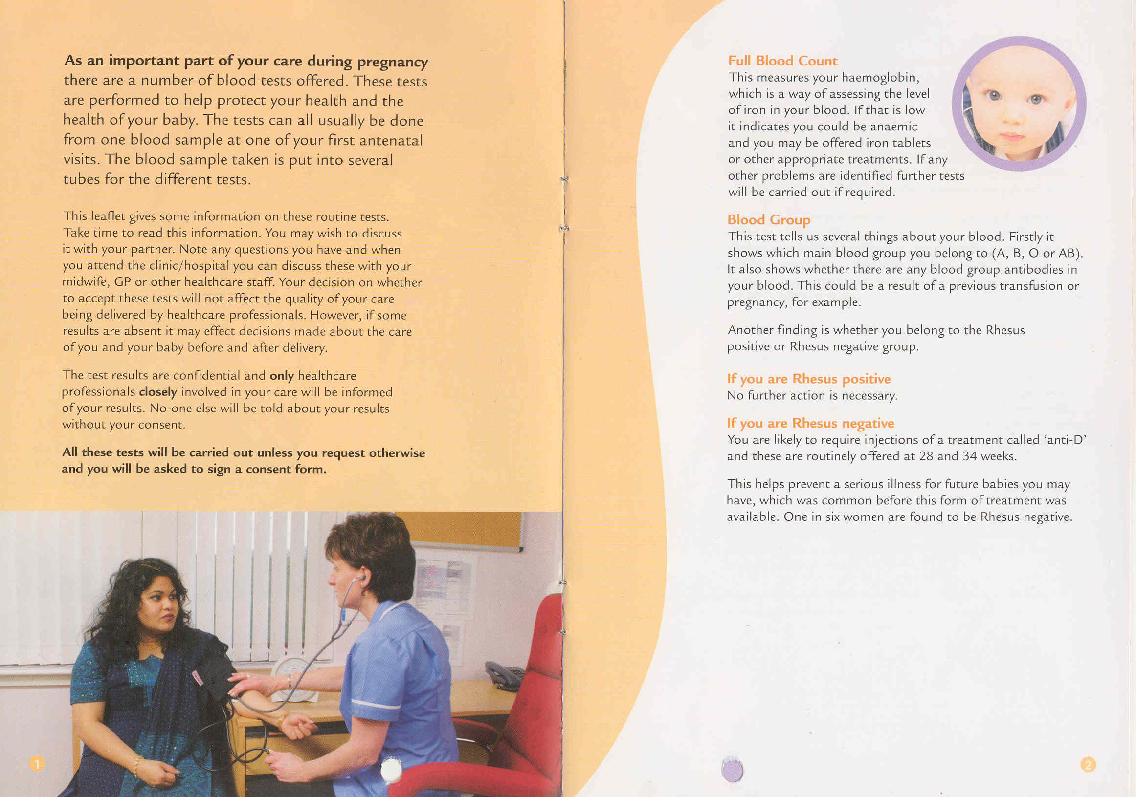
Original Blood Test Information

Slide 22
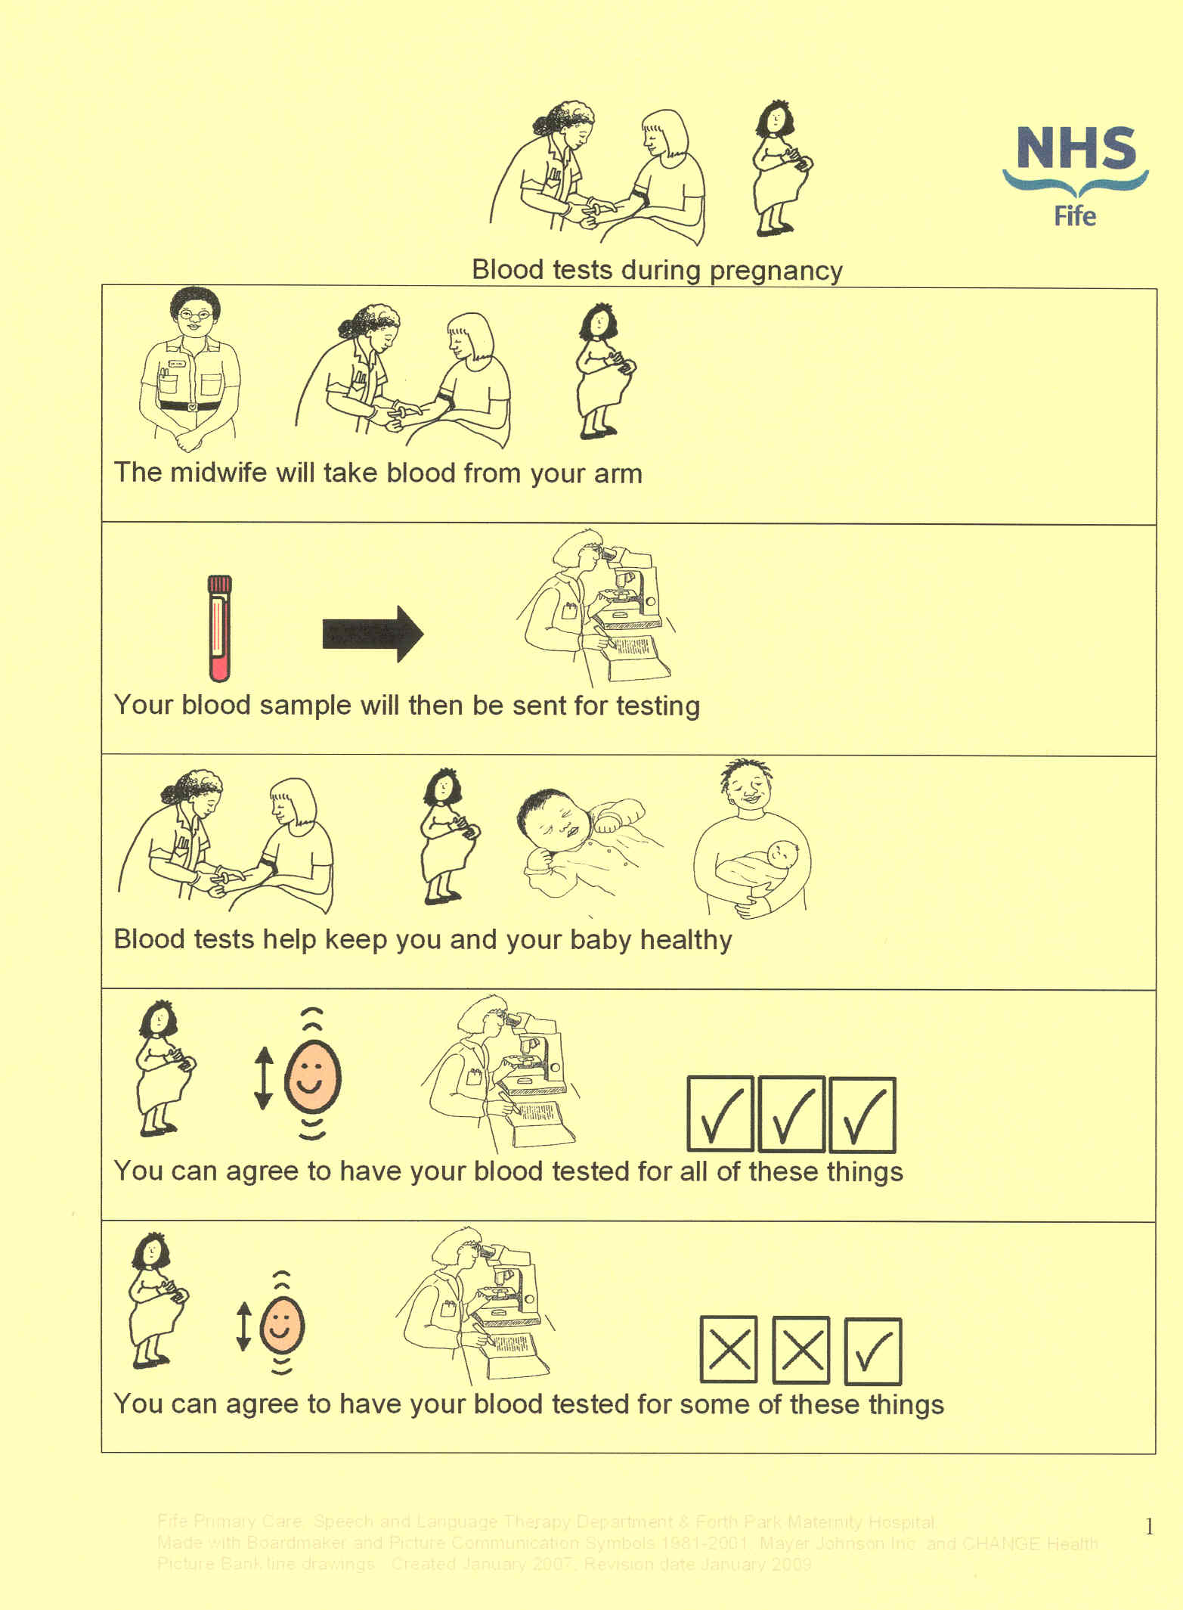

Section of Adapted Blood Test Information

Slide 23
The need to recognise LD..
Porter, E. et al (2012) Developing the support pack for people who have a learning disability. British Journal of Learning Disabilities; 40: 4, 310-317
Qualitative interviews with midwives during the development of the Support Pack indicated their lack of confidence about identifying people with a learning disability.
A simple screening tool was subsequently introduced.
A screening tool can only provide initial indicators of whether a person might have a LD.

Slide 24
The Learning Disability Screening Questionnaire (LDSQ)
Karen McKenzie & Donna Paxton
7 items which are quick and easy to administer and score.
Can be completed with or by the individual or someone who knows him/her well.
Requires minimal training.

Slide 25
The Learning Disability Screening Questionnaire (LDSQ)
Karen McKenzie & Donna Paxton
Age range 16 years upwards.
Cost effective.
Quick and simple to administer and score
Valid and reliable

Slide 26
Findings
In 15 mths, the service assessed 75 women. Of these, 4 scored as having a possible LD on the LDSQ.
Accessible materials were used with these women.
50% of those with LD were referred on to other agencies (n=2). The other 50% already had other agencies in place.
Of those with LD, an early home visit by the midwife took place prior to the 12-week scan for one person.
A multi-agency planning meeting took place at 22 weeks for these women.

Slide 27

Mellow Babies Group
Each week we started with a warm up i.e. “name game” each person tells their name and whether they like it.
The group work together on a team building activity i.e. “The perfect parent”
Group lunch
Joint play
Mums video session
Have a go! Homework i.e. “bubbles”

Slide 28
Mentors
Mentors support these activities by visiting the mums each week, working through the activities together, discussing the group and settling any concerns for the parent.
This is vital as it gives additional reinforcement and clarification especially for mums with learning difficulties.
Parents build a relationships with the mentors and may confide in them rather than disclose personal issues in the group.
We had three mentors. One each from the following services - Homestart, Barnardos and Family Support Service.
This working partnership proved to be successful. As facilitators we met up each week with the mentors to discuss concerns and progress to ensure that the mums got the maximum benefit from the group.

Slide 29
Evaluation
The evaluation is being lead by Beth Tarleton from Bristol University.
Raq Ibrahim and Kirstin O'Neil from Mellow Parenting based in Glasgow will collect data.
After all data is collected a final report will be delivered in the summer 2015
The evaluation has been approved by the University of Bristol’s Research Ethics Committee for the school for policy studies.

Slide 30
Community Learning Disability Team Nurse
Interventions
Augment the role of midwifery services by enabling the expectant mother to understand their ante- natal care utilising available resources. This will involve close liaison with the midwifery service and an agreed role in reinforcing particular elements of the ante-natal care package and information given to the mother. Support parents to attend ante- natal appointments and classes if required.
Provision of health education.

Slide 31
Community Learning Disability Team Nurse
Interventions
Monitoring of mother’s physical and mental health including continence issues, contraceptive advice, continuing dental care, monitoring for post-natal depression etc.
Teaching of practical skills as required:
  Family healthy eating- education/guidance
  Cooking sessions using visual cookbook ( adult meals) and provision of accessible shopping list to facilitate purchase of required ingredients
  Demonstrating preparation and storage of baby foods (with guidance from Health Visitor on current best practice)

Slide 32
Community Learning Disability Team Nurse
Other Interventions
Both ante and post natally, supporting parents to understand and negotiate Child Protection Procedures
Explaining role of Children and Families Team and reasons for their involvement
Support to attend meetings and facilitate understanding of outcomes
Arrange for provision of information in accessible format
Support to attend court if necessary
Organisation of Care programme approach where necessary

Slide 33
Pathway Challenges
Effective working with Children and Family Social Work Services and Adult Social Work services
Supporting mothers post-natally and into child’s early years
Developing protocols, procedures and further training to support the pathway
Evaluation of ante-natal pathway

Slide 34
Contact Details
Dr. Eleanor Porter – Clinical Psychologist
eleanorporter@nhs.net
Alan Roberts - Service Planning and Development Manager
alanroberts@nhs.net

Slide 35


Slide 36
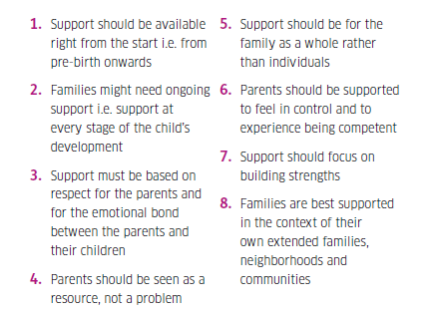
Principles of Supported Parenting

Slide 37
3 Sections:
Key Features of Good Practice
Good Practice When Child Protection is Needed
Good Practice in Commissioning

Slide 38
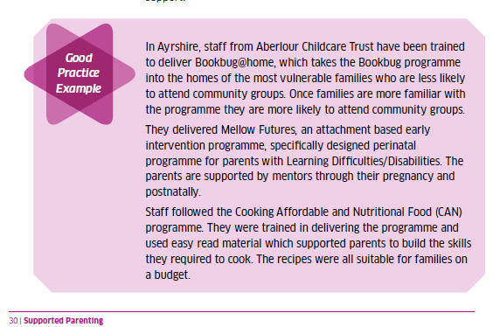
Good Practice Examples

Slide 39
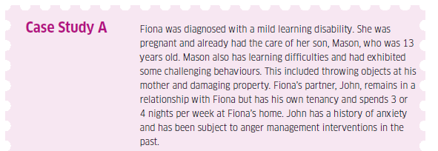
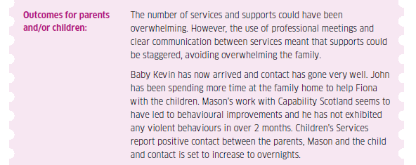
Case Studies

Slide 40
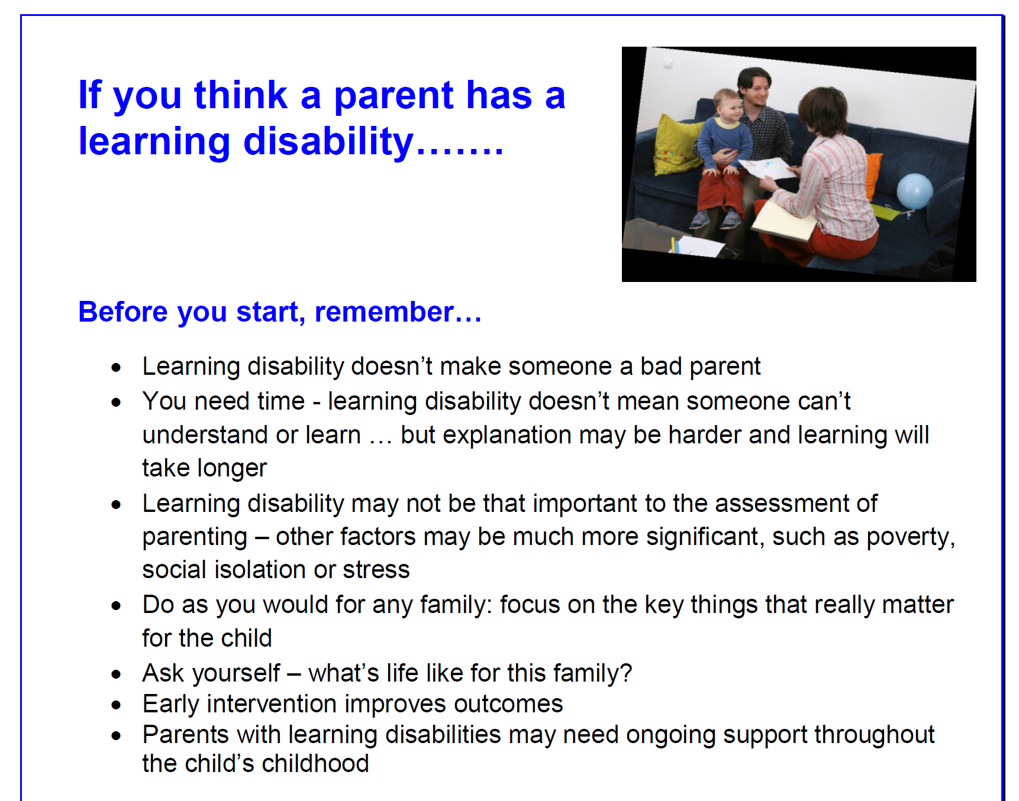

Slide 41


Slide 42


Slide 43

3rd June 2015
Glasgow
The economic case for early and personalised support for parents with learning difficulties (LD)
Annette Bauer
PSSRU, Social Policy Department
London School of Economics and Political Science

Slide 44

PSSRU (Personal Social Services Research Unit); part of LSE Health and Social Care
Notes:
Our new website ☺;

Slide 45
Why supporting parents with learning difficulties (LD)?
At much higher risk of losing their children into care
More likely to be involved in child protection cases: 15% to 22% of parents involved in child protection conferences and care proceedings have LD (Brandon et al 2009)
Often LD not identified
Parents with LD less likely to seek help (Cleaver & Nicholson 2008)
Need for additional support as well as responsive mainstream services
Evidence (from other areas) demonstrates cost-effectiveness of early intervention (e.g. Allen 2011)

Slide 46
Background Small research study commissioned the Working Together with Parents Network (WTPN)
Question Which types of early and personalised support for parents with LD is cost-effective?
Aims To generate and summarize knowledge on cost-effective support for parents with LD
To search for evidence on costs and economic consequences of different types of care packages

Slide 47
Method
Case studies of projects that provide support to parents with LD
  Electronic survey with practitioners (semi-structured);
  Questions about parents’ characteristics; resource inputs as part of a care package; outcomes achieved;
  Assigning unit costs to resource inputs and outcomes (economic consequences);
  Assumptions about duration and intensity of services from other data sources (where this information was not available from case studies)
Literature review
  Pragmatic
  Search for evidence on the costs and outcomes of interventions that support parents with LD

Slide 48
Findings
We identified economic evidence on the following interventions:
Advocacy
Shared lives
Intensive family interventions
Public Social Partnership
Parenting programmes
Parenting training (could include parenting programmes)

Slide 49
Advocacy
‘Taking action to help people say what they want, secure their rights, represent their interests and obtain services they need’
Lewington & Clipson 2004, p4
Previous research by myself and colleagues on advocacy for parents with LD found
Return on investment of 2.0 from a government perspective i.e. £2 pound return for every pound invested;
Costs of advocacy ranged widely; average costs were £3,040 per case

Slide 50
Advocacy
example case study, from our previous research
(in summary)

Slide 51
Advocacy
Possible reduction in safeguarding activities, care proceedings and arrangements, worth £720 per parent
Possible economic benefits linked to increased access to early interventions, worth £3,130
Costs of advocacy: £32 per hour, mean length of intervention 95hrs
Wide range of outcomes: mental wellbeing, placement stability, better relationships with children who had been previously removed, school attendance and performance
Bauer A, Wistow G, Dixon J, Knapp M (2014), Investing in advocacy for parents with learning disabilities: what is the economic argument?, British Journal of Learning Disabilities. doi: 10.1111/bld.12089

Slide 52
Advocacy
Factors that positively influenced outcomes:
Early referral: Good practice meant receiving a referral no later than the initiation of a Section 47 enquiry
LD as main reason for parents’ disengagement from child safeguarding process;
How advocacy made a difference…
Raised professionals’ awareness of and attitudes towards parents with LD;
Improved joint working with parents;
Increased time spent considering options and evaluating possible decisions;
Improved interagency working around parents’ needs.

Slide 53
Advocacy
Findings from case study
Costs of care package £37,109;
Included advocacy (£12,500); mother/baby foster placement (£8,400);costs for care proceedings (£4,825); tenancy and financial support incl. housing benefit support (£4,003); social services legal activity for children in need (£2,385); parenting capacity assessment (£1,273); family support worker (£923), social worker (£923)
Return on investment: 2.3
Savings based on annual costs of foster care between £83,585 and £85,045

Slide 54
Shared Lives Schemes
Here: parent and their child(ren) who need support and accommodation become a regular visitor to, or moves in with, a registered shared lives carer
“Carers and those they care for are matched for compatibility and then develop real relationships, with the carer acting as ‘extended family’ ” (Shared Lives Plus Ltd. 2011)
Total costs of shared lives: £485 to £712 per week and £25,220 to £37,024 per year;
Vast majority is payment to carer (NAAPS 2009; Social Finance 2013; PSSRU Unit costs for health and social care 2013/14)
Return on investment from literature ranged between 1.7 and 2.4

Slide 55
Shared Lives Schemes
Case study
Costs of care package: £47,738; this included shared lives support (£25,220), social worker (£11,400), special parenting (£5,850), health visitor (£3,380), core group meetings (£1,848)
Return on investment: 1.9 based on prevented foster care and prevented expenditure for housing benefits for the period of a year
Savings based on annual costs of foster care between £83,585 and £85,045 and cost of housing support £3,744

Slide 56
Intensive family interventions
Care coordination approach: key worker works with a range of agencies to provide a period of intensive support for high risk families often with the aim to prevent children’s entry into care (e.g. McDermid and Holmes 2013)
Costs for this support ranged widely between £5,140 and £23,000 (excluding accommodation);
Return on investments for troubled family programmes ranged widely and were arguably unrealistic in size (based on savings for family eviction)
E.g. Flint et al 2011 estimate at 8.0; and DCSF (2009) estimate of up to 25 for family intervention programme

Slide 57
Intensive family interventions
Case study 1: Child disability social worker
Cost of care package (excluded were costs of service related to child disability) £32,427; this included costs of child disability social worker (£7,349), family support worker (£5,400), care proceedings (£4,825), child in need support (£4,238), advocacy (£4,263), health visitor (£2,600), midwifes (£2,600), CBT (£930), adult learning disability team (£134), befriending (£88)
Return on investment: 2.6
Case study 2: Valuing parent support service (Tarleton et al 2011)
Cost of the intervention was £8,450; costs of care package were not evaluated
Return on investment 2.7

Slide 58
Family Support Public Social Partnership (PSP)
Works with parents with LD and their families to enable them to access services in their homes and in the community; consultative, asset based approach in which local networks and resources are identified and utilised
Costs of care package: £42,219; this included the support by PSP (£1,100), care proceedings (£4,825), adoption (£27,000), advocacy (£4,263), welfare advice and housing benefits support (£4,003), social group (£88), health visitor (£260), midwifes (£260), social worker (£220), voluntary sector worker (£200)
No immediate cost savings because child was given to adoption but this was considered the more appropriate care arrangements; likely that positive long-term outcomes were achieved for child and parent bit difficult to evidence

Slide 59
Parenting programmes, training and support
Positive Parenting Programme (Glazemakers et al 2013)
=Adaptation to Triple P: longer sessions, more time for relationship and trust building, additional contact between sessions, home session to help parents implement new knowledge; additional elements such as domestic violence, housing problems
Parents achieved some positive outcomes
Costs were not measured but likely to be higher than costs of Triple P
Training interventions for parents with LD (Cochrane review)
=Different types of training but common aim to help parents protect their children from harm, parent more effectively and prevent their children being removed from home
Interventions improved child health knowledge, recognising dangers, home precautions, child care routines, maternal child interaction
Costs not evaluated
Parenting programmes to address specific problems relevant for parents with LD e.g. child abuse, child behaviour, child (learning) disability (Cochrane review, economic studies e.g. Bonin et al)
Programmes more likely to be cost-effective if they reduce child behaviour problems

Slide 60
Adult learning approaches
(e.g. McGaw et al 2002, Booth and Booth 2003, McConnel et al 2008)
For mother with LD, 12wks intervention; involved group meeting as well as one-to-one support, focused on individual goals and strengthening social relationships
Interventions achieve improved psychological wellbeing and social contacts, quality of life and self-confidence to access support
Befriending programmes or home visiting
(e.g. Fraser et al 2000; Mead et al 2010)
Targeted at high risk populations
Showed reduction in social isolation and improved mental health

Slide 61
Return on investment for support for parents with LD, from a government perspective
Intervention | Cost of care package | Return on investment (range) | Sources
Advocacy | £37,109 | 2.0 to 2.3 | Bauer et al 2013, case study
Shared Lives | £47,738 | 1.7 to 2.4 | NAAPS 2009, Social finance 2013, PSSRU 2014, case studies
Intensive family interventions | £32,427 | 2.6 to 2.7 | Case studies
Public Social Partnership | £42,219 | None | Case study

Slide 62
Challenges and limitations
Evidence on long-term support from case studies and literature; evidence on short-term support from literature only
Cost of care package versus intervention
Case studies often did not provide sufficient detail so assumptions needed to be made about the duration and frequency
Units of costs from the literature did not always match with the units reported in case studies
Different time periods covered (12-24 months)
Return on investment in case studies based primarily on annual costs of foster care provision
A range of additional outcomes were achieved that could not be transformed (‘monetised’)

